Slide 3
Building a Successful Brand: Our Strategy
Reflect the mission
Brands are mission Driven: Mission is the very reason for existence.
Build Trust
Brands command a high level of Consumer Trust
Keep Trust Audience is high energy, high on passion folks: Keeping their trust is critical
DEVELOP BRAND IDENTITY
EXPRESS BRAND
PROTECT BRAND
Create
A Target market
A Superiority Claim
A Reason Why
Engage
Interact
Involve
Scandals and Criticism
Associations with undesirable corporations
Competition Attack
Brands can easily be destroyed, they rely heavily on trust & are vulnerable
Notes:
People don’t buy what you sell but they buy WHY you sell. Its not anymore how it used to be like you have a customer support desk and all queries and issues remain inside those 4 walls.

Slide 4
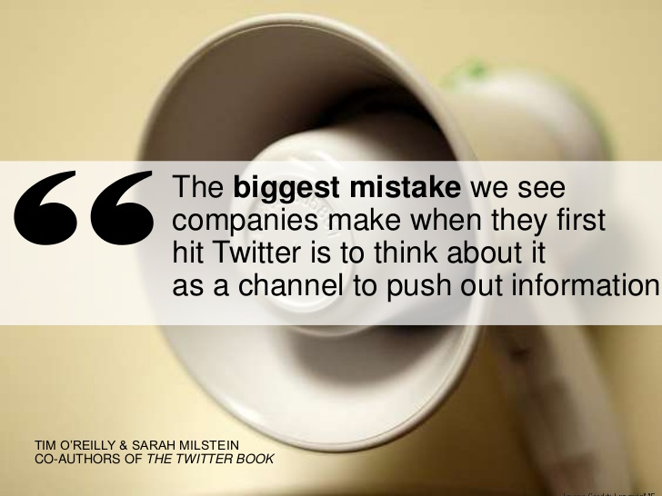
Notes:
Its no more the case. Companies need to be little more intelligent.

Slide 7
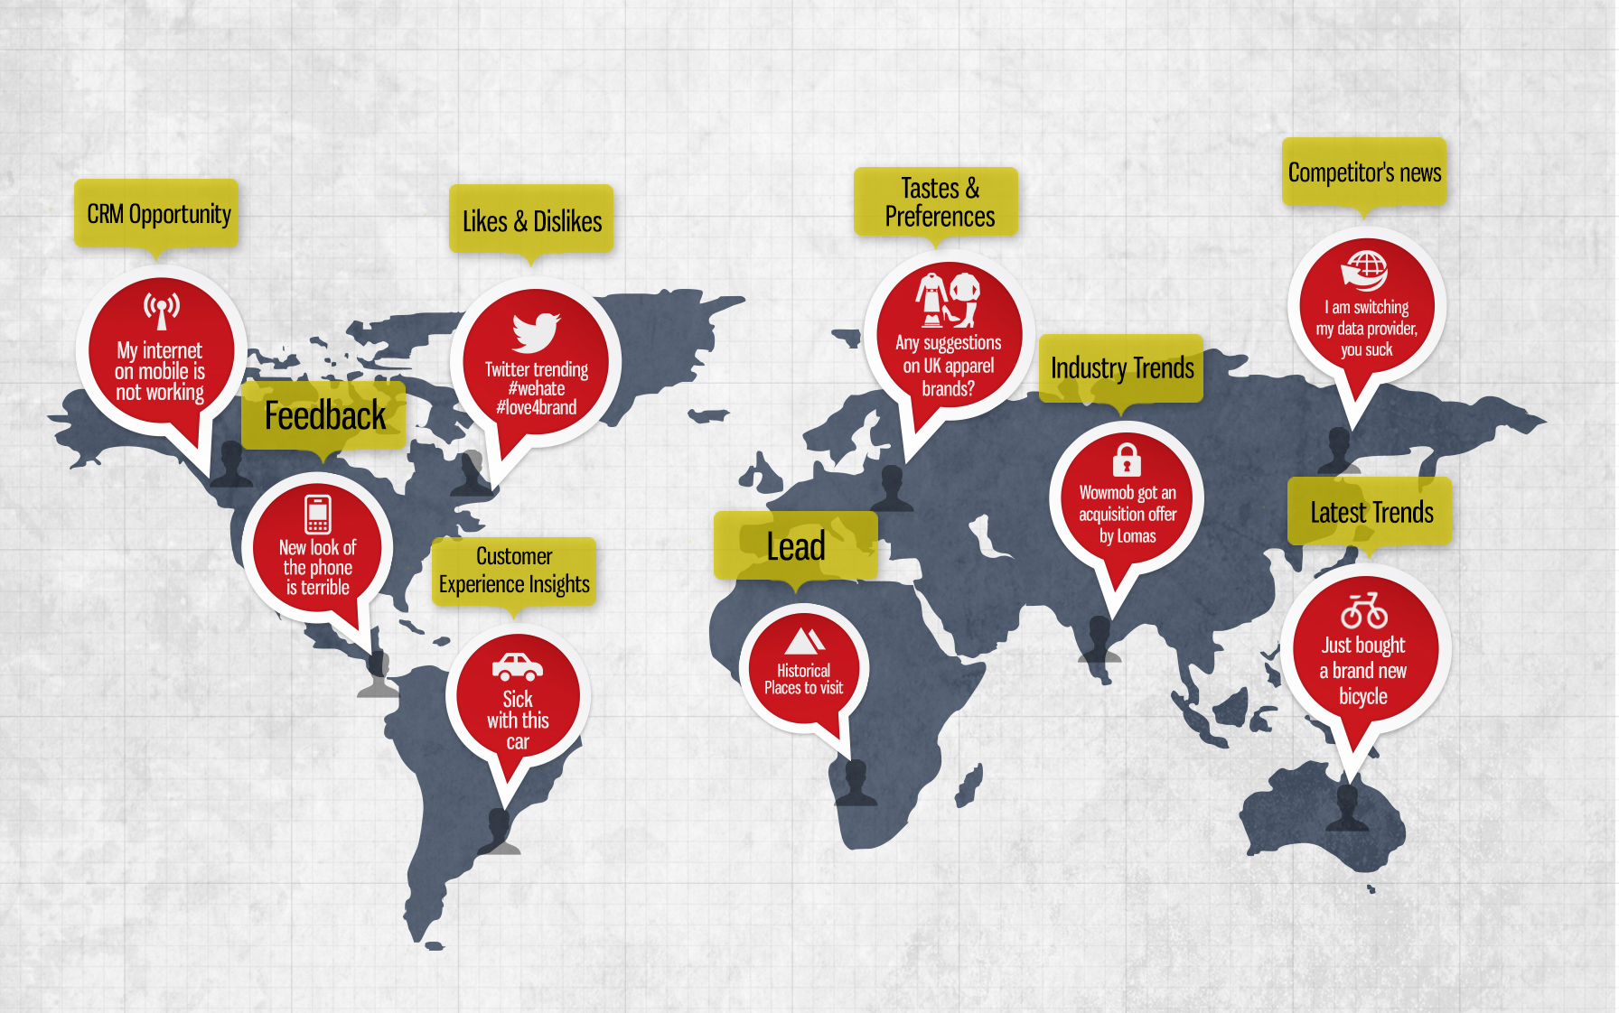
Notes:
But remember, Social media not about hunting, its about farming, its about cultivating relationships

Slide 8
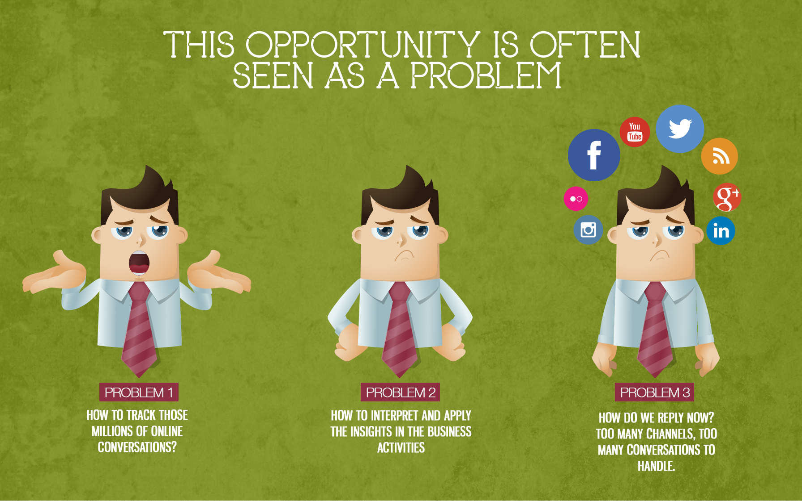
Notes:
Its simple, start by listening

Slide 10
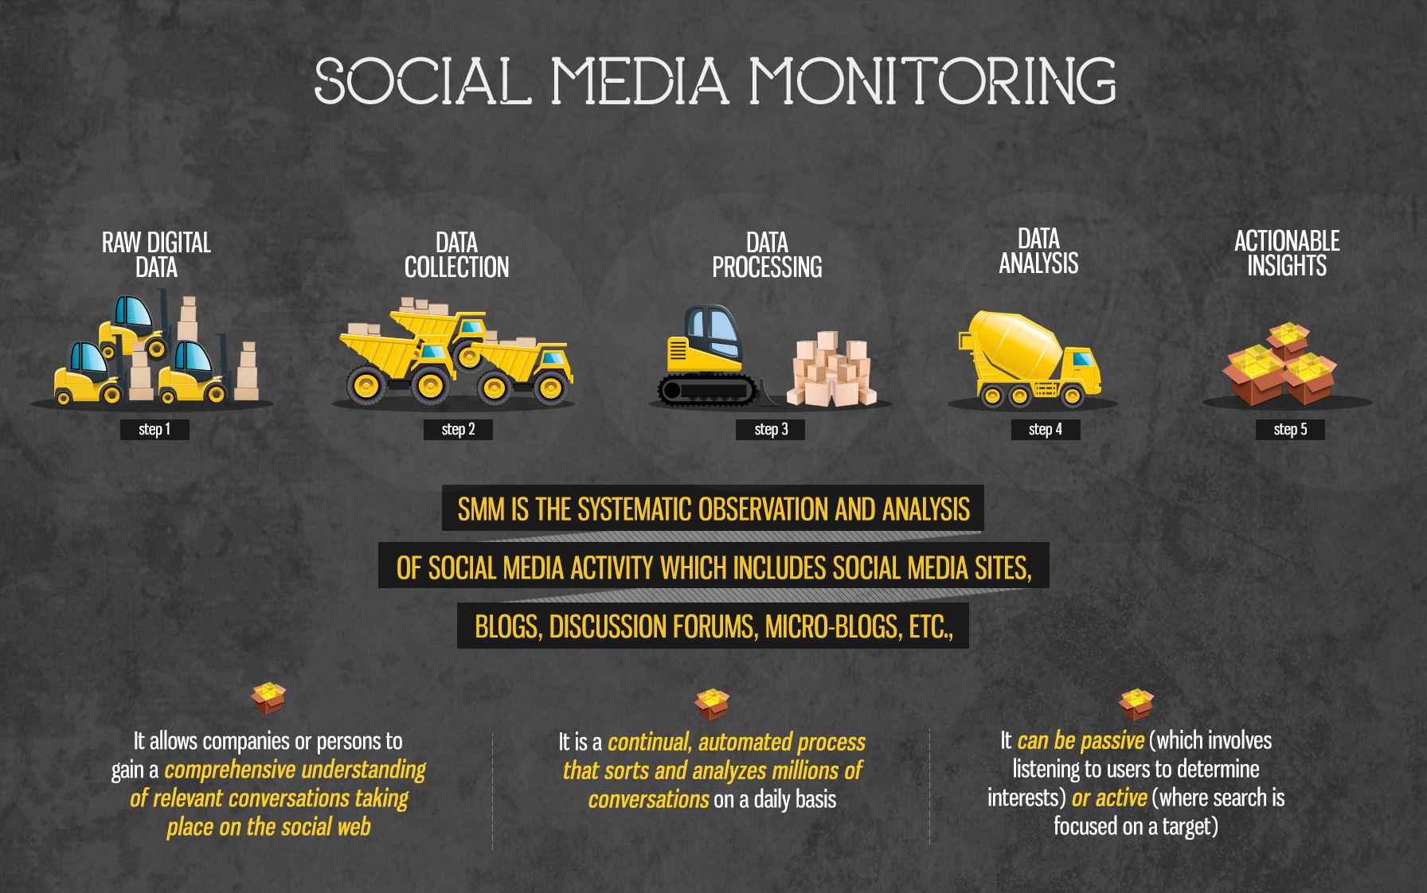
Notes:
So lets start listening.

Slide 11
Simplify360

Slide 14
Sneh Sharma
Founder & CEO
Mail - sneh@ittisa.com
Twitter- @onlinesneh

