Slide 1

Understanding and Enhancing Customer Experience Using Digital
Sheyantha Abeykoon
July 2015

Slide 2


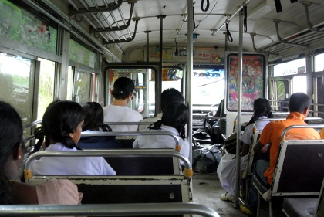


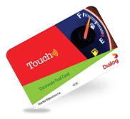


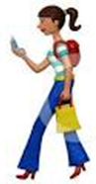
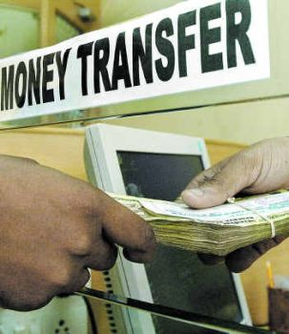




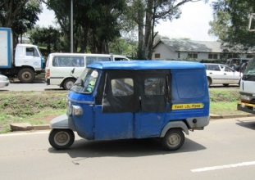



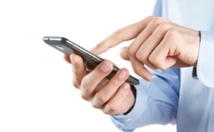


Digital Services : The opportunity to intermediate in the transactional journey of a typical consumer
Food and Dining
Digital Services
Consumption Conversion Model
Public transportation
Health
Food
Transport
Communication
Entertainment
Education
Shopping Goods
Other
Micro Segmentation
Travel
Transferring Money
Health
Services
Location based
Purchasing
Taxi Services
Shopping
DCL | July 2015

Slide 3







Dialog/Axiata Digital Services Focus
Digital Commerce
Digital Money
Digital Advertising
Digital Entertainment
M2M Connected Devices
Online Shopping (OMP, C2C, B2C)
Price Comparison
Bookings – Events, Leisure, Health
Mobile Money
Mobile Payment
Micro Lending
NFC, OTT Wallet
Messaging
Display
Insight/Analytics
Video
Music
Gaming
Learning / Edu
Events / News
Navigation
Telematics
Home Security
Smart Metering
√
Not transitioned to ADS yet
√
√
√
√
√
√
√
Regional Business in D-ADS and D-Commerce
OFW - Digital Services Delivery Framework (Remittance, Gifting, Entertainment…)
DCL | July 2015

Slide 4



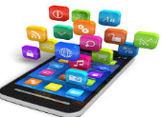


WoW.lk: From leading daily deal company to largest ecosystem of online services
Largest online ecosystem
- Destination for shopping needs
- Classifieds with hit Ad partnership
- Travel, Movie tickets, events
- Tri lingual with a focus
on the mass market
Over 320 K Customers
Most visited e-commerce site
Investing in Mobile
- e-commerce and mobile commerce expected to coverage
- 30% of traffic is now on mobile devices
First Non Credit Card
Installment scheme
Online Mall
- Online Mall on the open market place model
- Universal catalogue to consumers across the country
- Market access to smalltime merchants
Launch of travel and Tickets portal
Classified
Partnership
Daily Deal Model
- Played a catalytic role in e-commerce adoption’
- Many merchants and consumers had their first digital experience
First to launch credit card promotional schemes
First to Cash on Delivery
First to launch Mobile Bill Payments
DCL | July 2015

Slide 5

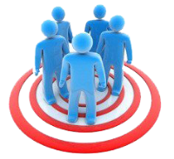

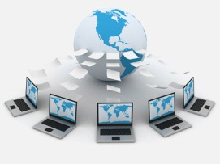
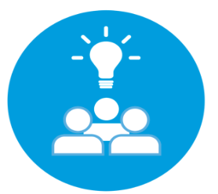
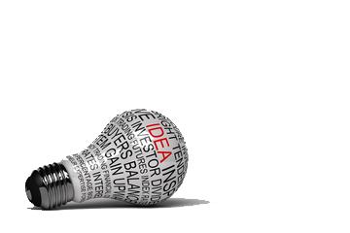
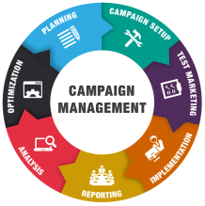
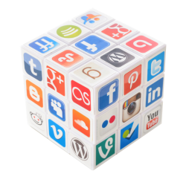
Analyzing the Digital Consumer : The opportunity to intermediate in the transactional life of typical consumer
Audience Building
- Behavioral : Value buyers, high spenders, frequent buyer
- Transactional: Smart phone buyers,
- Interest : Travel, gardening
Content Groups
- Product Groups: accessories, toys, giftables
- Blogs, articles, news feeds
- Product pairs, combos
BI & Analytics
Analysis and Testing
- Analysis of results against objectives
- Analysis of click through and conversion rates
- ROI and CAC
Data Capture
- Email Click through
- Browsing patterns
- Transactional data. location data
- Demographics
- Survey Responses
- Social media campaigns
Execution Mediums/Tools
- Onsite Personalization [Oracle ATG]
Targeted Email campaigns
SMS, outbound calls
Social Media Marketing/Remarketing
Campaign Management
- Cross Sell Campaigns:: product upsells based on profile
- Content Marketing: Blog articles, or how to use manuals based on products purchased
DCL | July 2015

Slide 6
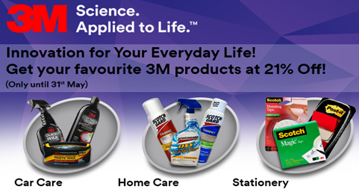
3M : An example of a Targeted Digital Campaign within the wow.lk ecosystem
Campaign Outcome
Campaign was run for a duration of 6 weeks.
Average monthly purchases increased from 50 [Average] to 350 [Average]
Gender : Female
Age: 25 - 55
On site Personalization
Registered users
+
Email subscribers
Impulse Buyers
Email Newsletters
SMS
Interest: Home Products
DCL | July 2015

Slide 7
The Customer Funnel : Unique engagement for customers at different stages of the funnel
Registered Subscribers
2
1
One Time
Infrequent Buyer
3
Repeat
Buyer
Loyal
Customer
4
5
Advocate
Customer Profiling, Product upsells and cross sells, personalized offers
Customer referrals, Testimonials
Customer Education Campaigns
Gathering more customer information :Surveys
Activation: Steep Discounts, Customer feedback/surveys
Focus on retention, reward schemes, exclusive offers, loyalty membership
DCL | July 2015
DCL | July 2015

Slide 8


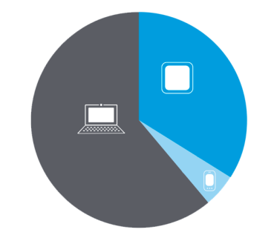






Extending Services to Brands : WOW.lk works with large brands to build a digital presence and drive engagement
Brainstorm & Develop
Online Strategy
Creating Online Portal
Product Launch & Brand Pulse Test on WoW Digital Platform
On site
Personalization
Web
Traffic
Fulfillment
Target Customer Groups
Product categories
Online Positioning
Social Media
Tools
Reports &
Feedback
Deals and Cx
Accusation
Customer
Service
Digital Reach:
Emails & Newsletter
Customer Data
DCL | July 2015

Slide 9
Thank you
Understanding and Enhancing Customer Experience Using Digital

