Slide 1

Mind of a Disruptive Leader

Slide 2

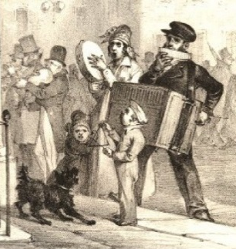
Live
1800

Slide 3
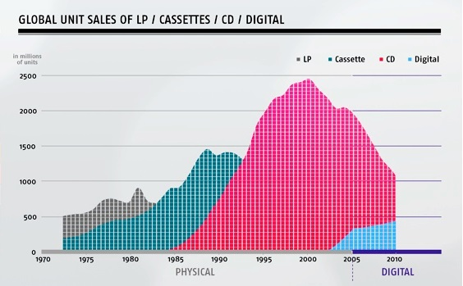

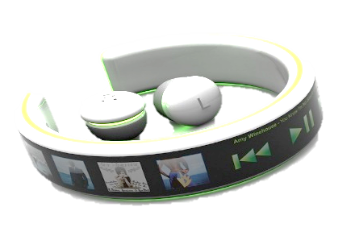
4 years later
Immediate future
1 year later
8 years later
100 years later
Bracelet
Skinny player

Slide 4


1977
Vinyl
1978
8-Track
1978
Cassette
2000
CD
2003
iTunes
2007
Grooveshark
44 mins
$ 25
46 mins
$ 24
60 mins
$ 16
74 mins
$ 20
4 mins
$ 0.99
∞ mins
$ 9
On-demand Streaming up 54% with 164 Billion Streams in 2014

Slide 5
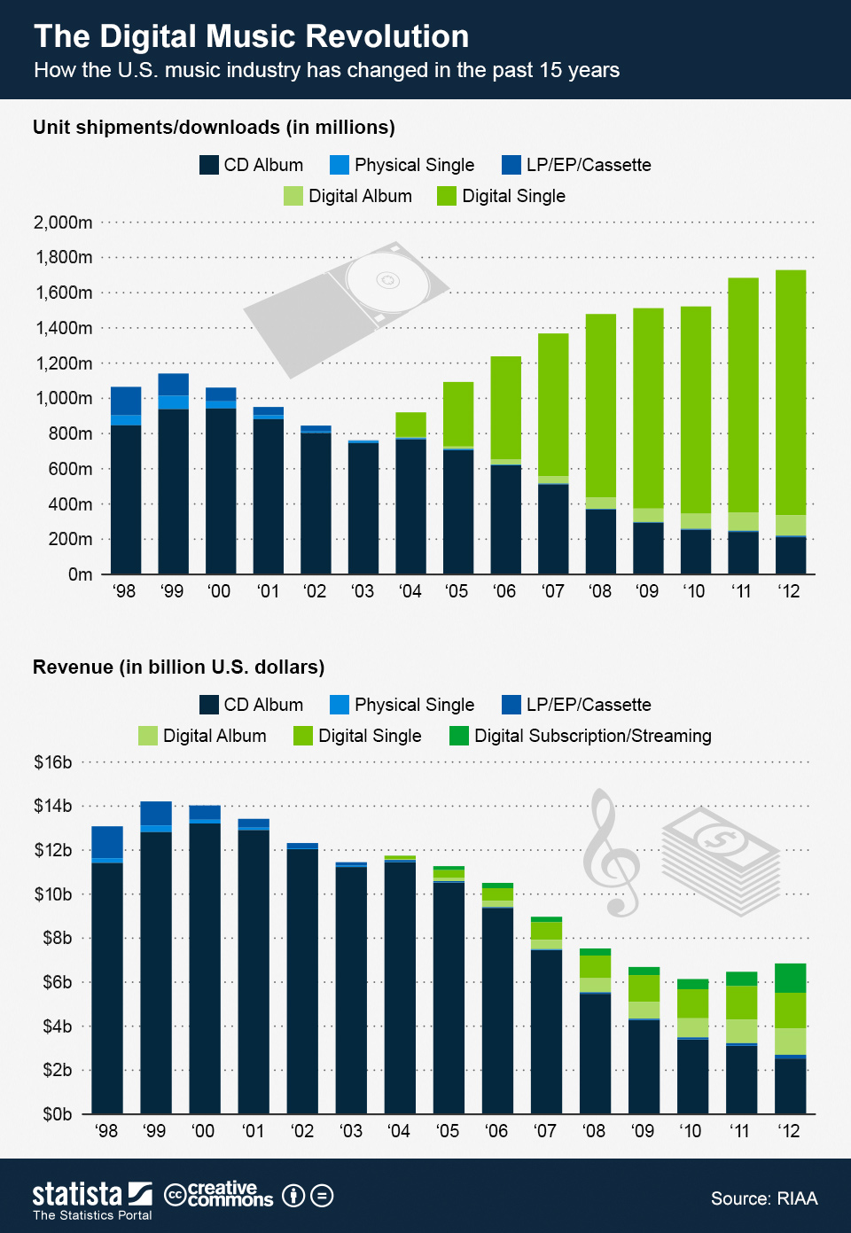
US Market

Slide 6
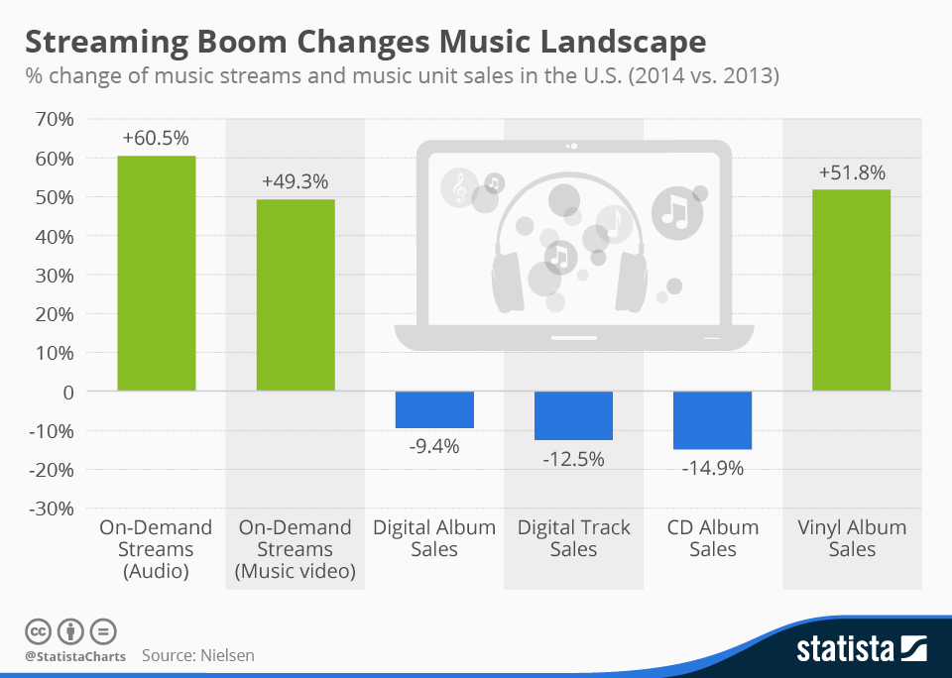

Slide 7
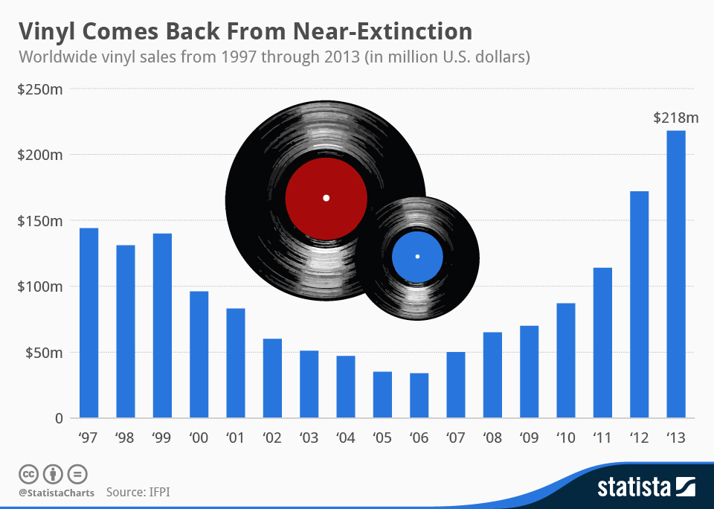

Slide 8
The future is defined by outliers not by those around the mean invest in outliers

Slide 9

$5 Billion in 5 Years

Slide 10






Nest Labs
Home Automation
$3.2 billion
Makani Power
Clean Energy
$30 million
Boston Dynamics
Robotics
$500 million
Zagat
Restaurant Reviews
$151 million
Titan Aerospace
Drones
$60 million
DeepMind
AI
$650 million

Slide 11
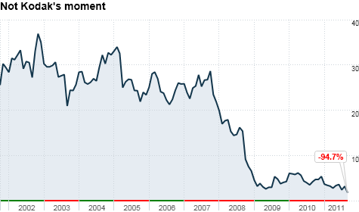
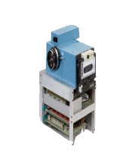
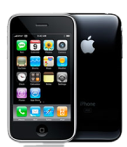

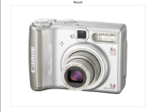
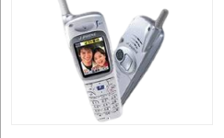
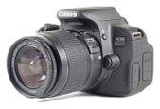
1984
First Digital Camera
Share Price
2005
Canon Powershot 5 MP
2007
iPhone
2000
First Camera Phone
INEVITABLE?
2000
First DSLR

Slide 12
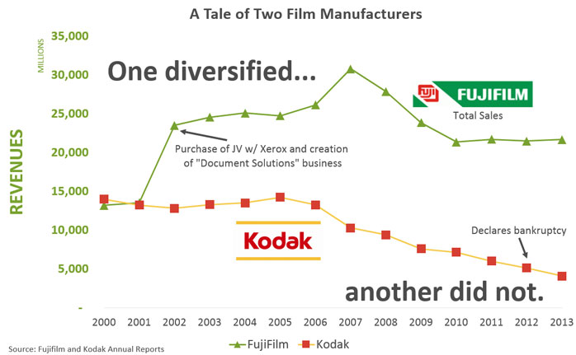
Figures in US$

Slide 13
Success is not determined by how much you do today of the present but how much you do today of the future

Slide 14
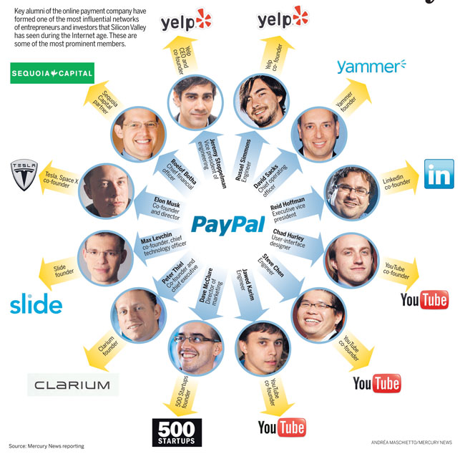
PayPal Mafia to be around 220 people
7 distinct "unicorn" companies
2 of those seven companies valued at north of $10 billion

Slide 15
Do not accept, but confront Do not follow, but define & disrupt

