Slide 1
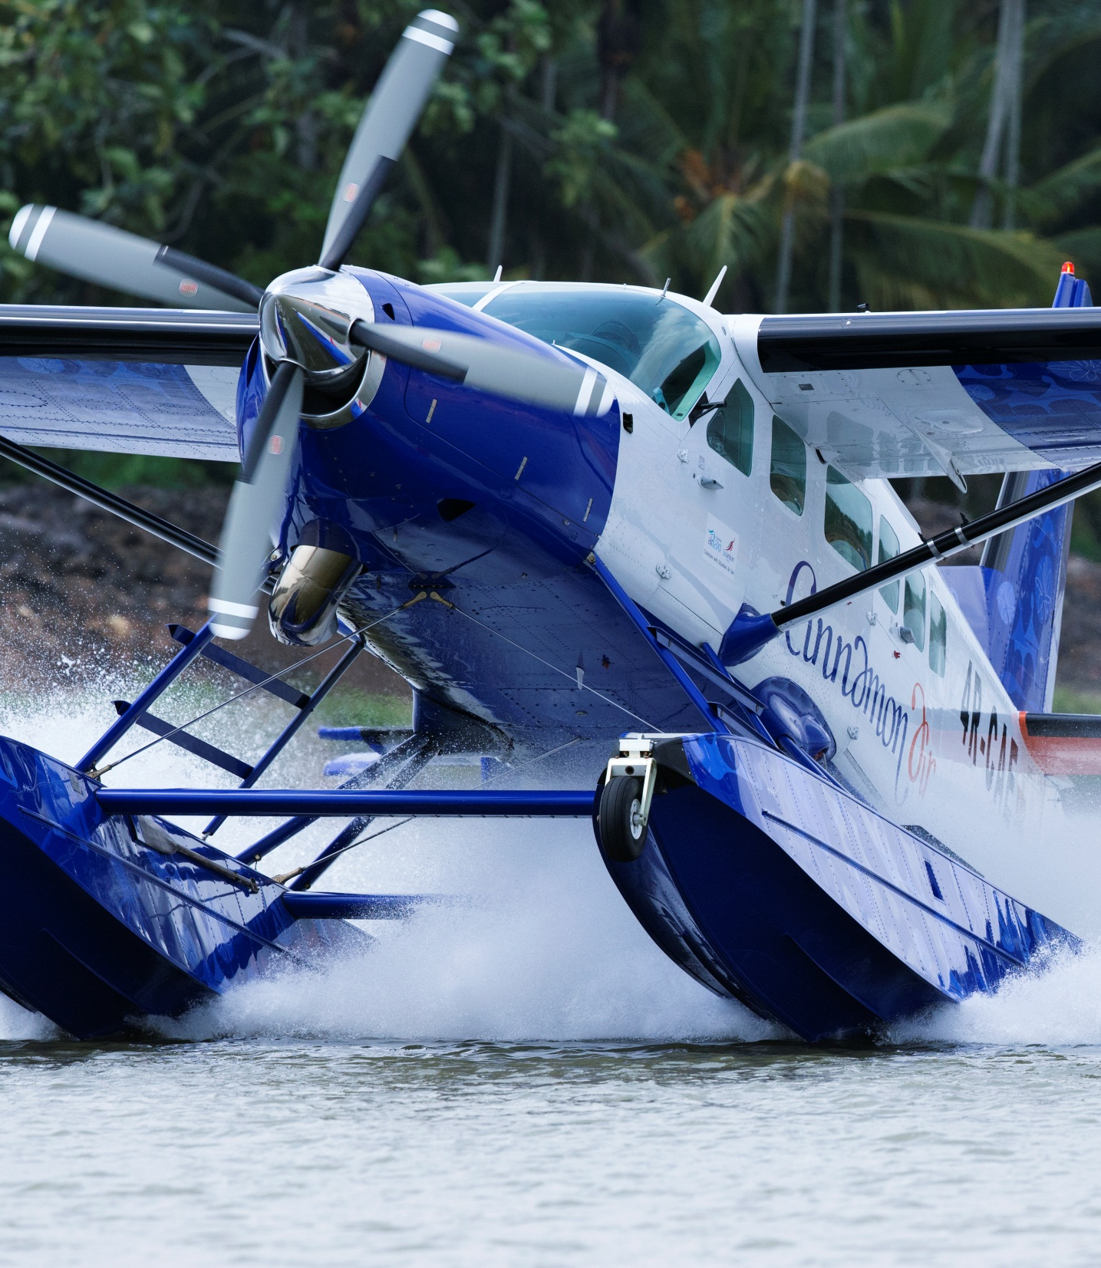


Understanding and Enhancing Customer Experience Using Digital – Cinnamon Air Case Study
LBR LBO Enterprise Summit, July 2015
Codeshare partner:

Slide 2
The drivers for a domestic airline – a confluence of factors
The peace dividend - resulting in a resurgence of foreign tourists
Forecasted change in dominant origin mix would mean shorter stays in-country
Increasing Indian and Chinese visitors vs. traditional European
typically 5 -7 days vs. 10 - 14 days
Travel time not relative to distance despite massive post conflict road building

Slide 3
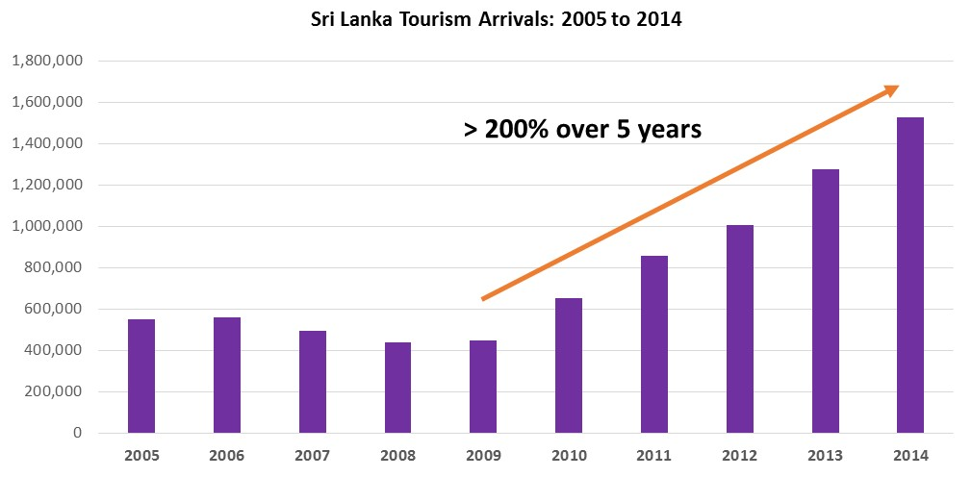
Growth in tourist arrivals
Source: Sri Lanka Tourism Development Authority, http://sltda.lk/sites/default/files/Tourism%20Growth%201970%20-%202014.pdf

Slide 4
Change in the dominant mix of tourists
India and China are the fastest growing markets
Source: Sri Lanka Tourism Development Authority, http://www.sltda.lk/sites/default/files/Annual_Statistical_Report-2013.pdf and http://www.sltda.lk/node/741

Slide 5
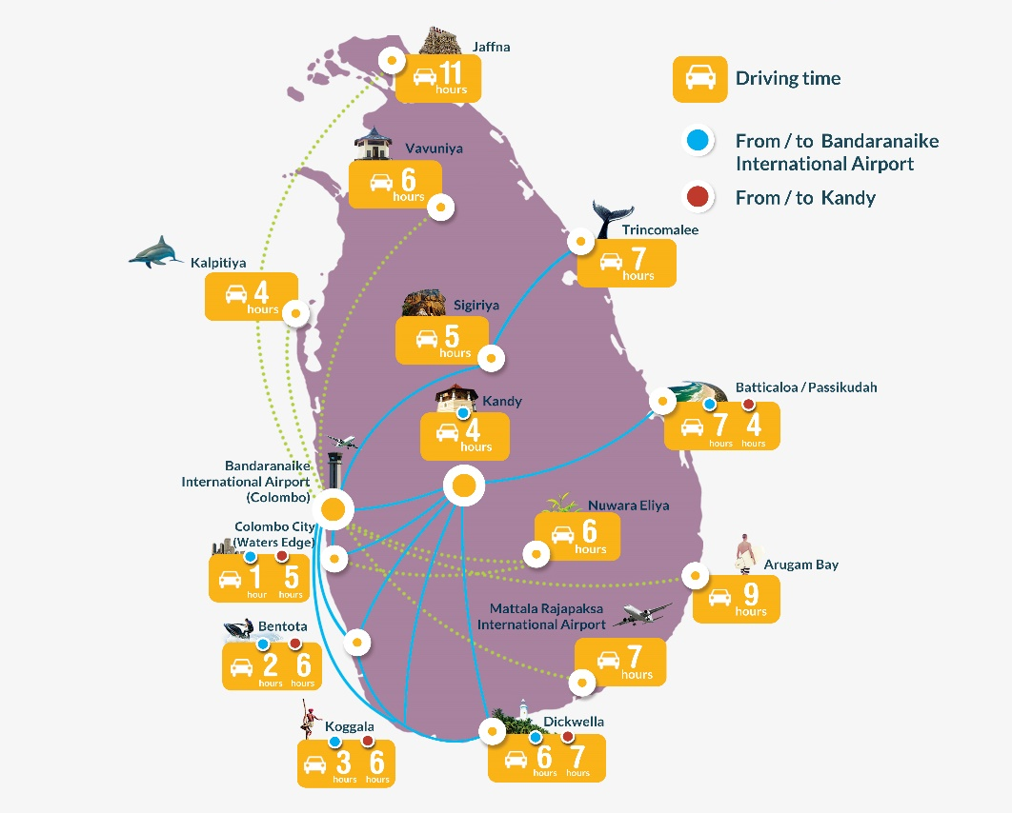
Travel time not relative to
Distances
East coast – 7 to 8 hrs
Kandy - 3½ to 4 hrs
Cultural Triangle – 5 to 6 hrs
*Driving times subject to change

Slide 6
Crafting the product – needed to address main pain points
Value adding and efficient - Time and unique perspective
Convenient – BIA access essential, primary catchment point
Reliable & Safe – published fixed schedule, world class equipment and personnel, operate to global standards
Affordable – not cheap, but a realistic alternative to air charter and an attractive upgrade from road travel
Accessible – all traditional distribution channels but new, non-traditional channels a pre-requisite to success

Slide 7
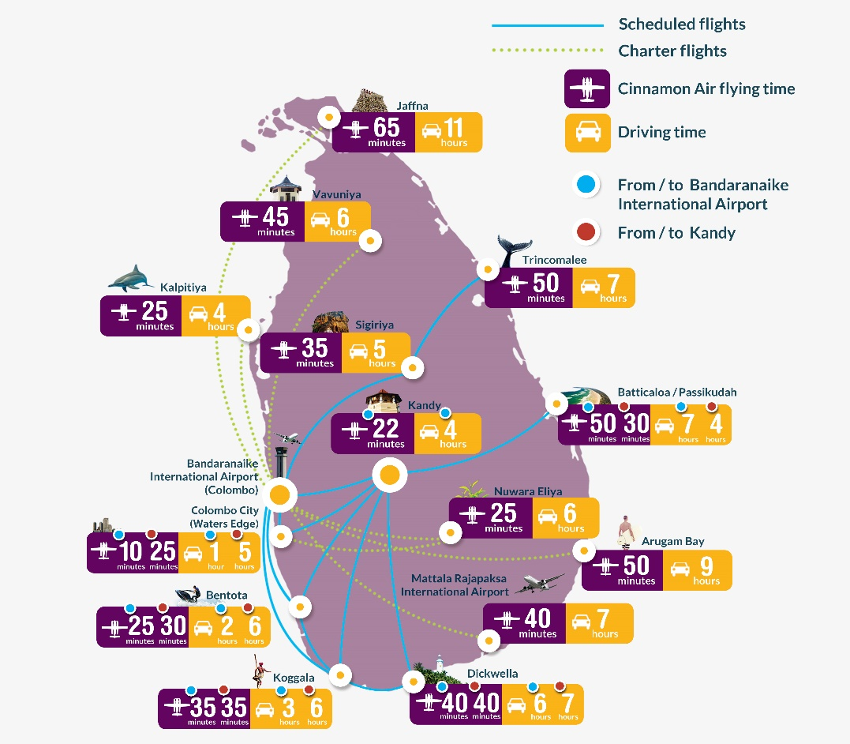
Air Travel vs. Road Travel
4 hour journey to Kandy in 20 minutes
8 hour road trip to the East coast in 45 minutes
Outstanding views of the country
*Driving and flying times subject to change

Slide 8








Traditional channels
Traditional Media
Referrals (Formal & Informal)
Destination Management Companies (DMCs), Foreign Tour Operators & Travel Agents, International Airlines, Hotels and Hotel Chains, and informal promoters
Events - International Trade Fairs and sales visits

Slide 9
Traditional channels
Effective use of these channels would be limited by:
High Cost – effective coverage likely to affect project viability
Segmentation & Targeting – complexities will lead to wastage
Time – traditional seasonal cycles, cost of gestation
Mind set and Legacy – not consistent, too expensive, can’t be done, threat of displacing traditional providers (other modes)

Slide 10
Employing digital channels had Primary Goals
Segmentation and targeting – tailor make campaigns to demographics and geographies
Reduce dependence on traditional channels – hoops and layers to navigate, mindset
Reduce traditional cost of distribution
increased yield
commission and discount structures
earlier, direct revenue realization, cash-flows and reduced receivables
bigger bang for a limited buck – wider reach, less dependence
Place the product directly in the face of the Consumer
reviews
position as a ‘must do in Sri Lanka’

Slide 11






Investing in multi-channel Digital Marketing capabilities
Versatile website – international booking engine, content, digital advertising
Social media – pictorial, current, exciting stories, videos
On line content of traditional news and travel media – credible journalists
Independent bloggers – large on-line following, live and experiential
Websites of traditional channel partners – linkages, specials, reservations
On-line reputation management – formal feedback, spontaneous review
OTAs – work in progress, low penetration for domestic air products

Slide 12
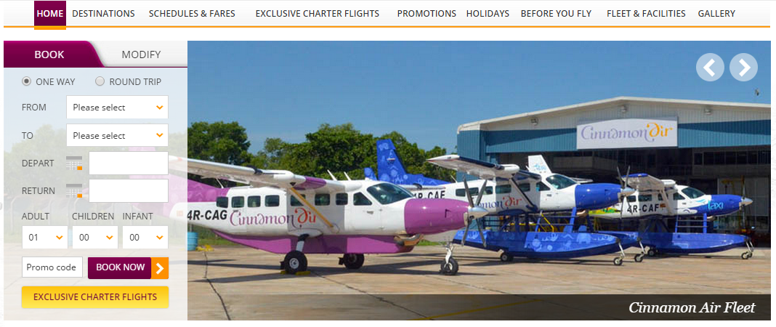
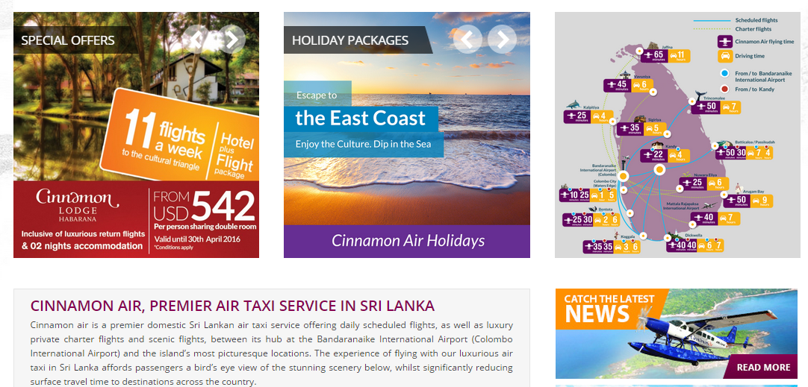
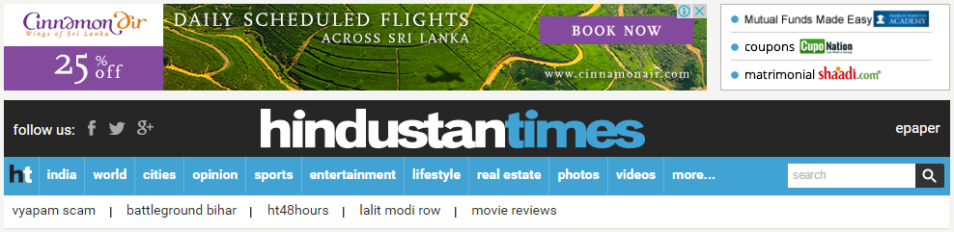
Versatile website
Booking Engine Widget
Digital Advertising
Search Engine Optimized Content

Slide 13
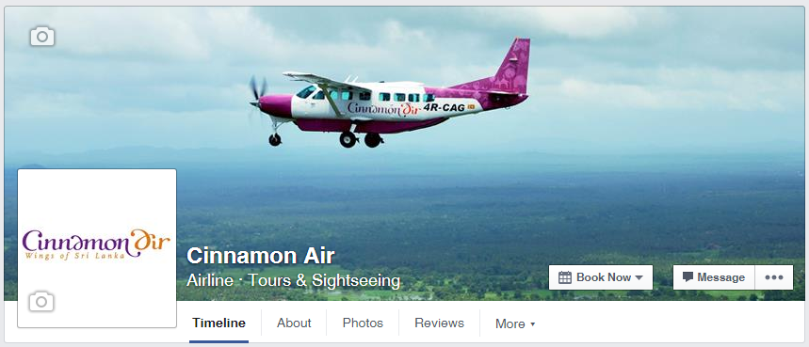

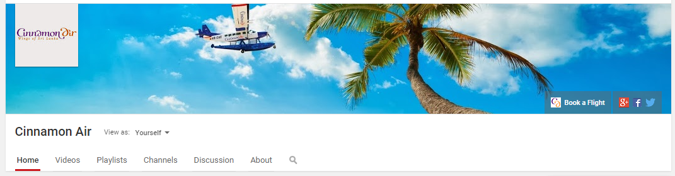

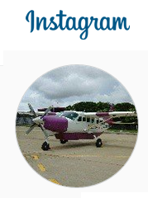
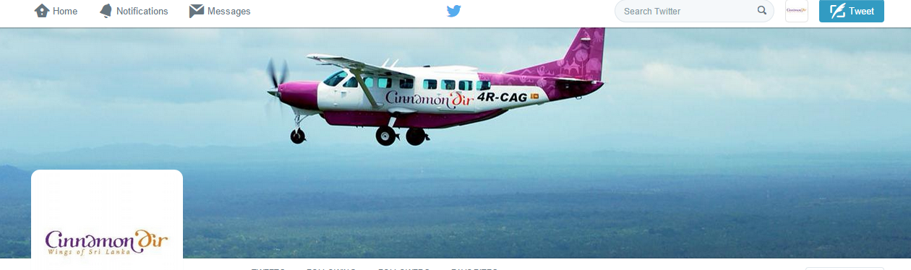

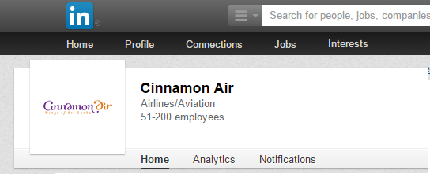
Social media

Slide 14
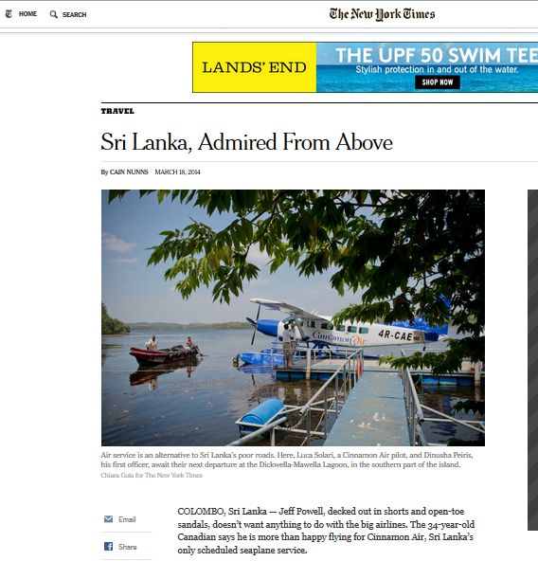
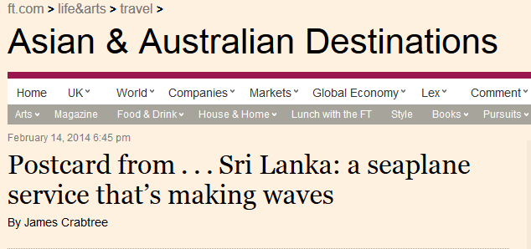
Online content of traditional news and travel media
Postcard from . . . Sri Lanka: a seaplane service that’s making waves, By James Crabtree, February 14, 2014
http://www.ft.com/intl/cms/s/2/3fb414c4-9248-11e3-9e43-00144feab7de.html
Sri Lanka, Admired From Above, By CAIN NUNNS, MARCH 18, 2014
http://www.nytimes.com/2014/03/19/travel/seaplanes-among-transport-choices-in-sri-lanka.html?_r=0

Slide 15
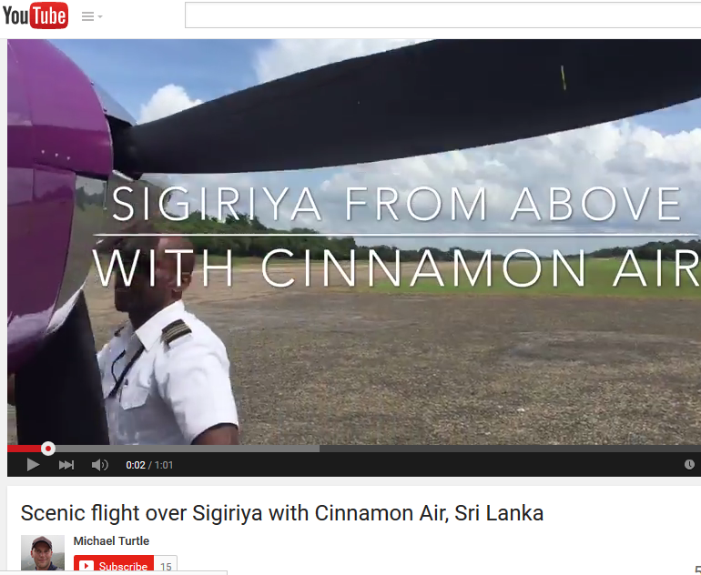
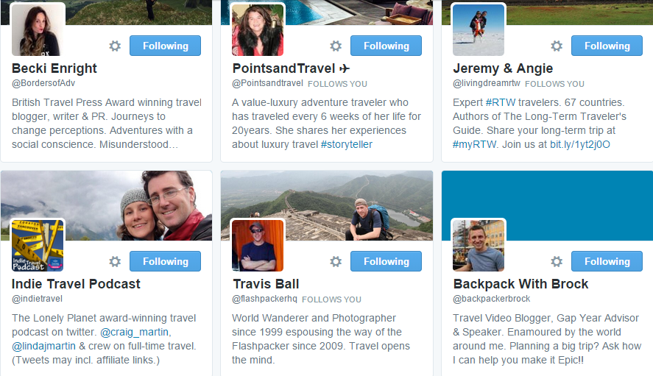
Independent travel bloggers
Scenic flight over Sigiriya with Cinnamon Air, Sri Lanka by Michael Turtle
https://www.youtube.com/watch?v=ek2W4vTA9o4

Slide 16
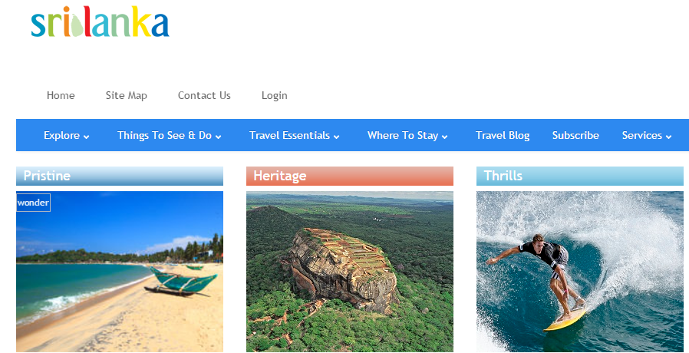


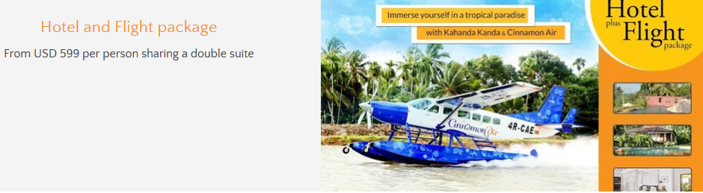

Websites of traditional channel partners
Sri Lanka Tourism Website – www.srilanka.travel
SriLanka Airlines Website – http://www.srilankan.com/airtaxi
Kahanda Kanda Website – http://www.kahandakanda.com/deals.htm
Cocoon Resorts Website – http://www.cocoonresortandvillas.com/
Cinnamon Hotels & Resorts Website – http://www.cinnamonhotels.com/Offers_CinnamonAir.php

Slide 17
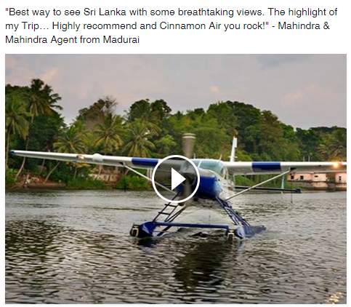
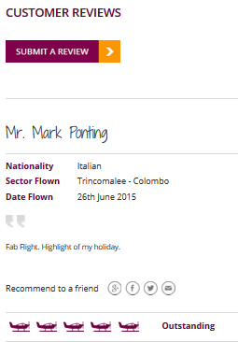
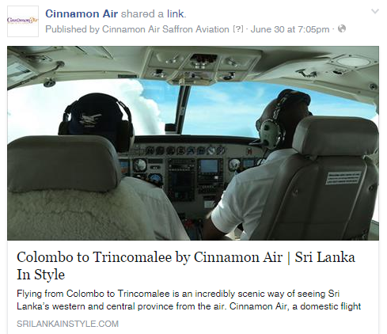
Online reputation management
*Reviews from Cinnamon Air’s Customer Review webpage and Facebook page

Slide 18






Online travel agents

Slide 19
Digital engagement - Early learnings & mid-term corrections
A robust platform and back end support infrastructure is vital
Invest in specialist skills sets in building digital capabilities
Executive enthusiasm, commitment and sponsorship
Plan in detail, Allocate meaningful funds
Review regularly
Experiment often
Re-charge the Talent Pool
Iteration, experimentation and learning to build a body of knowledge on what works for the sector
Notes:
A robust platform and back end support infrastructure is vital – invest at the outset in a solid base in terms of technology and support
Invest in specialist skills sets in building digital capabilities – both internal and external. Internally - traditional IT and Business Systems specialists are equally at sea and rely on learning on the job. Hire specialists and use external organisational resources for diversity and breadth
Executive enthusiasm, commitment and sponsorship - leadership engagement is critical – senior leaders must make the effort understand the different dimensions and work to align expectations with actions and results
Plan in detail, Allocate meaningful funds – understand the different streams and opportunities within the channel. Target specifics from each and allocate spend and resources accordingly
Review regularly – frequent planned review and daily pulse checks are critical. Change tack based on data and dynamics such as geographies, content etc.
Experiment often – change is constant and target groups tend to evolve based on actions. Allocate funds to try out new approaches
Re-charge the Talent Pool – bringing in additional (sometimes competing) outsourced third party talent increases the eyes on the goal and expands the skills sets deployed
Iteration, experimentation and learning to build a body of knowledge on what works for the sector

Slide 20




Robust platform and back end support infrastructure is vital

Slide 21
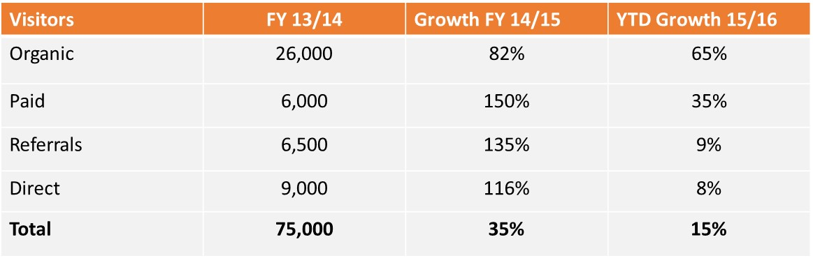

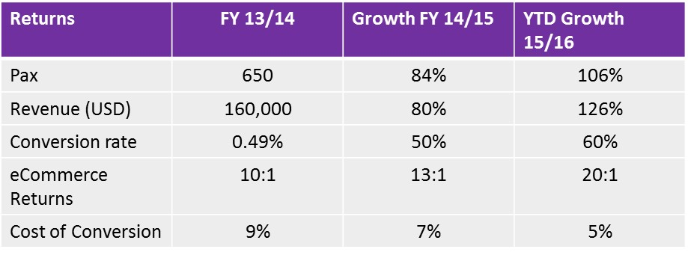
Conclusion - e-commerce returns
Encouraging results across key parameters
Source: Cinnamon Air

