Slide 1
Common characteristics of disruptive business models

Slide 2
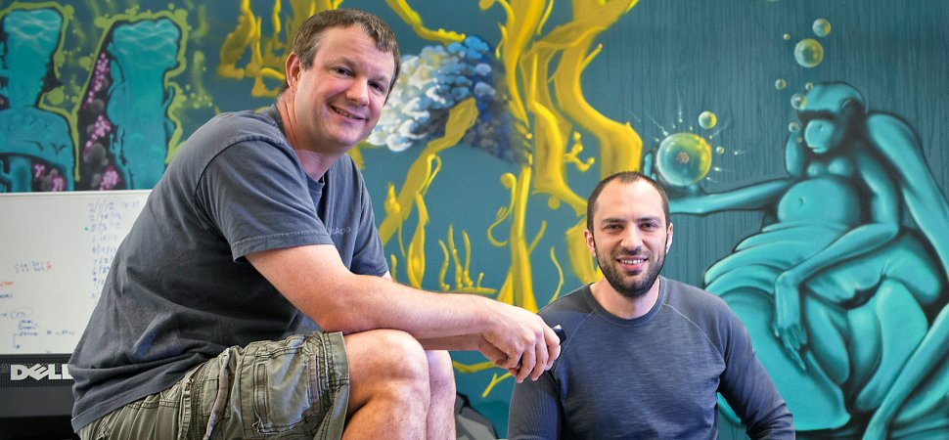
how do you know your idea is disruptive

Slide 3
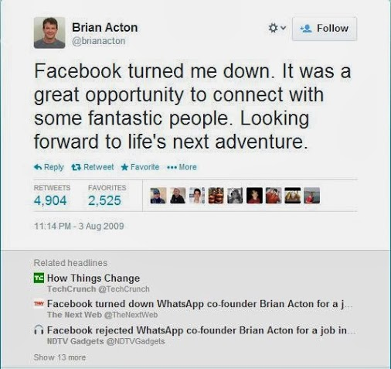
how do you know if you are smart enough to be disruptive

Slide 4
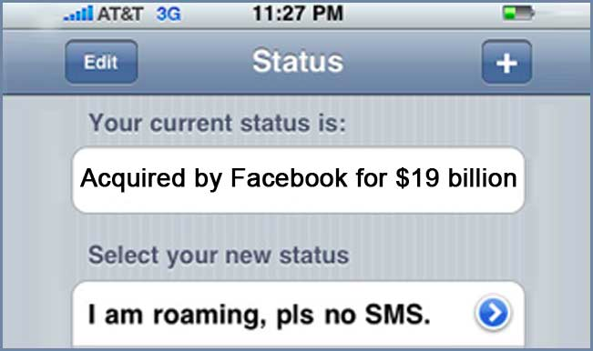
acquired by facebook for $19B

Slide 5
so what does a disruptive startup look like in their early days?

Slide 6
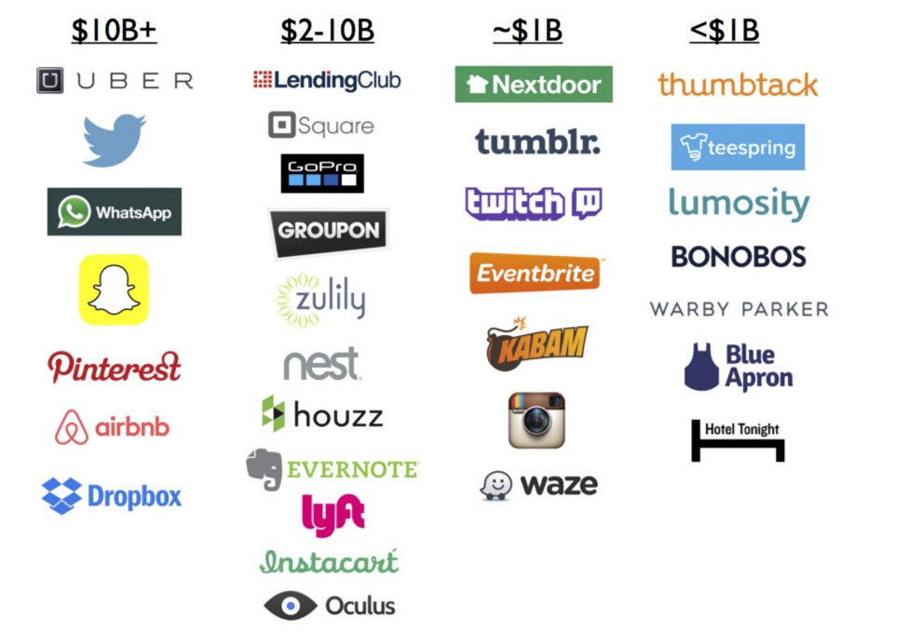
shasta ventures study

Slide 7
characteristics of disruptive startups
Most of the time only apparent in retrospect
Easy to dismiss ideas
Mostly in competitive markets with big incumbents
Re-invents user experience in a grand way
Founders are typically industry novices

Slide 8
is there any way to predict if a startup (idea) is disruptive or not?

Slide 9
probably not but…….

Slide 10
spectrum of disruption opportunity
market size
frequency of use
no regulation
demographic and infrastructure
customer pain

Slide 11
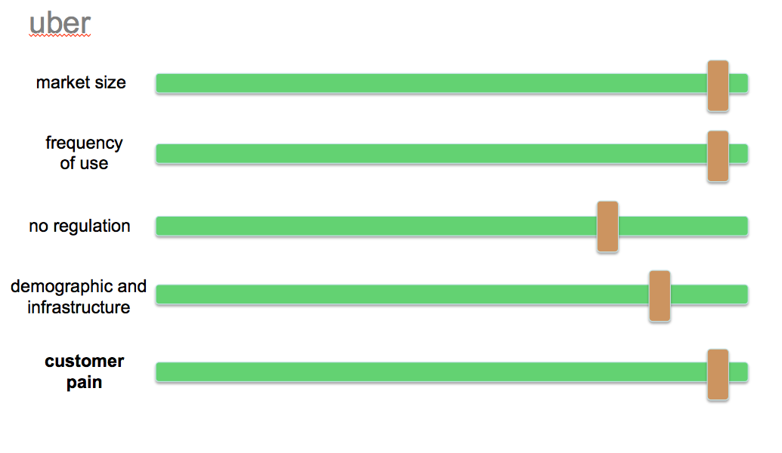
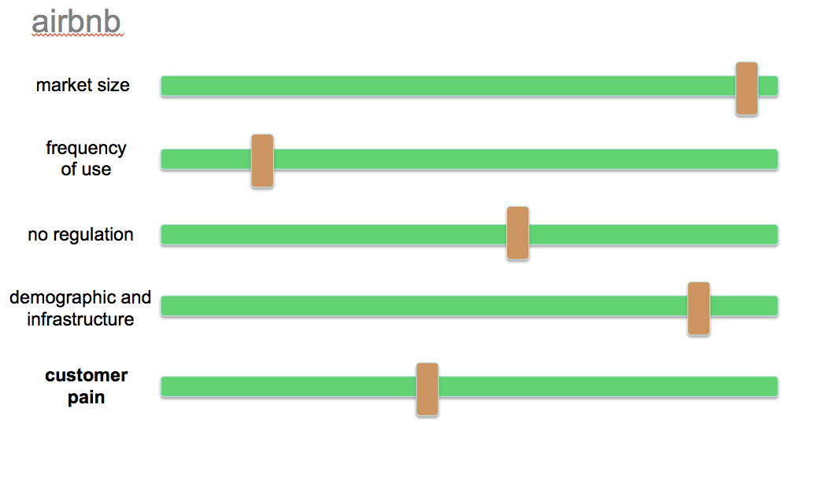
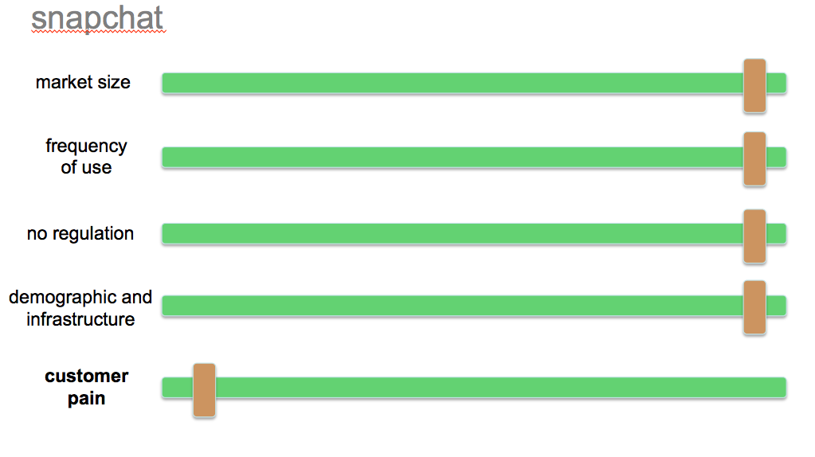
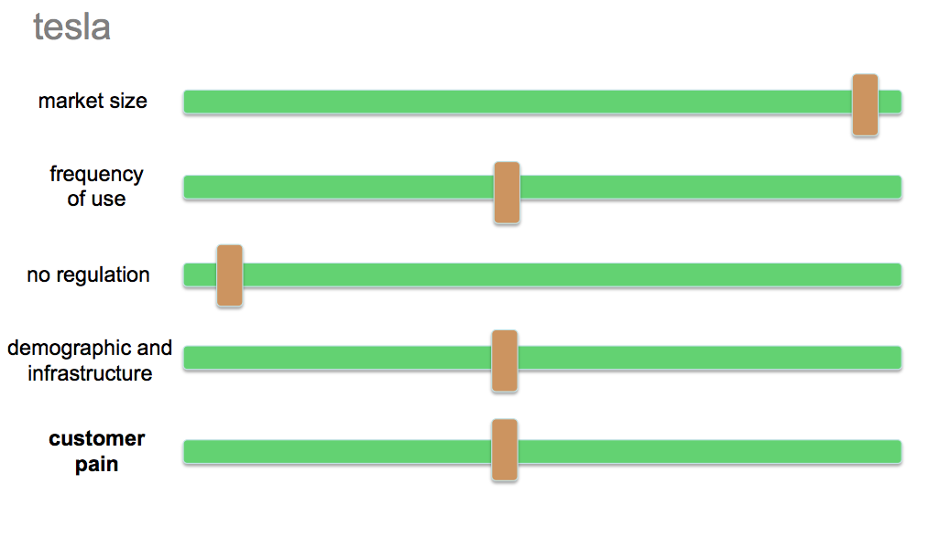
applied to a few companies we all know

Slide 12
so what does this all mean?
the higher the score in the opportunity spectrum the easier it is to disrupt the incumbent
the lower score the more you have to do:
10x better user experience
better design and product
need to innovate outside of the core product offering
takes longer and more “near death” experiences
but ultimately any industry can be disrupted. nobody is safe.

Slide 17
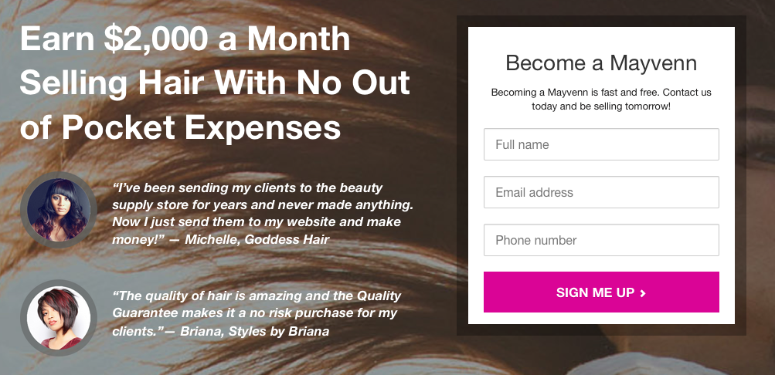

Slide 18
so,……can anyone build a disruptive company? yes

Slide 19
but not if you are in a big company

Slide 20
why not?
Need to protect existing customers and business models
Decision making by committee and therefore slower
Most decisions are data driven. What if the data is not available?
The more successful the company the more reluctance to change.
Failure = loss of credibility ………. or worse
Startups start at the bottom so have nothing to lose

Slide 21
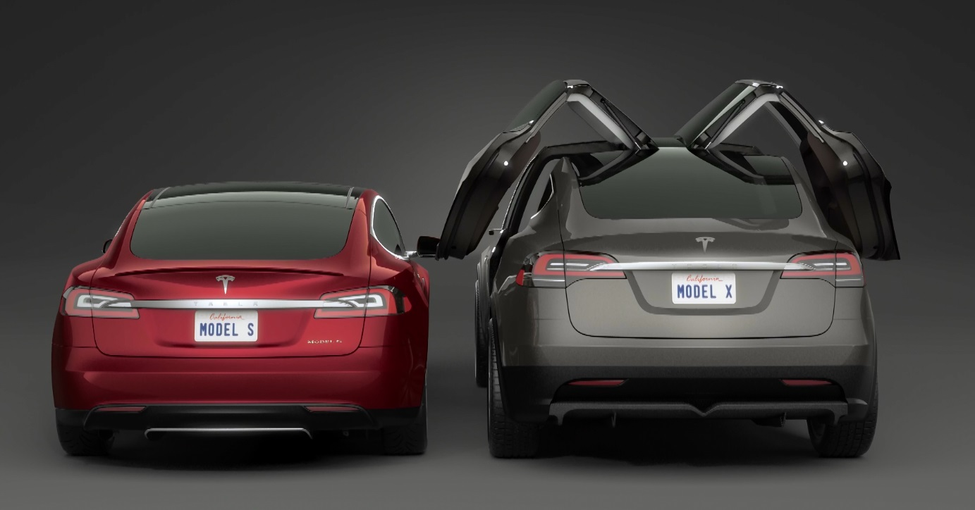
exhibit one - tesla

Slide 22
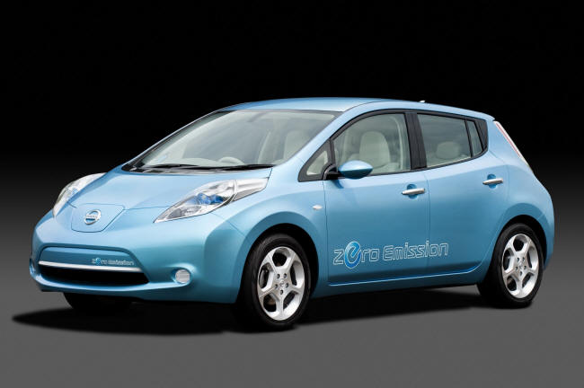
exhibit two – nissan leaf

Slide 23
i am a big company exec what do i do?

Slide 24
as a big company you CAN disrupt
But you need to get comfortable with the following
Agree to implement crazy ideas
Don’t be afraid of competitive markets
Realize you need to change user behavior
Find leaders who are not from your industry
And isolate that team from the rest of your company

Slide 25
be crazy

Slide 26
Brian Beach the challenges of creating disruption within a big company

Slide 27
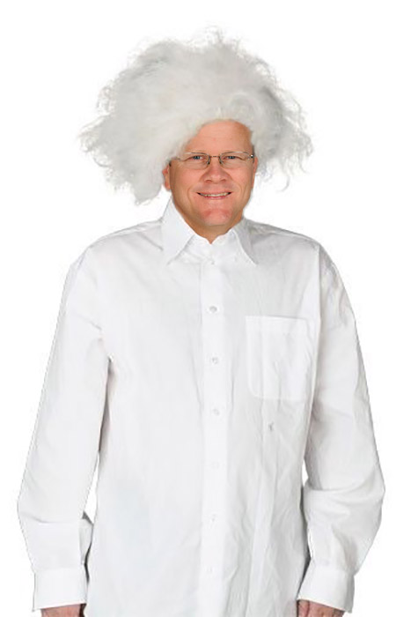
be crazy

Slide 28
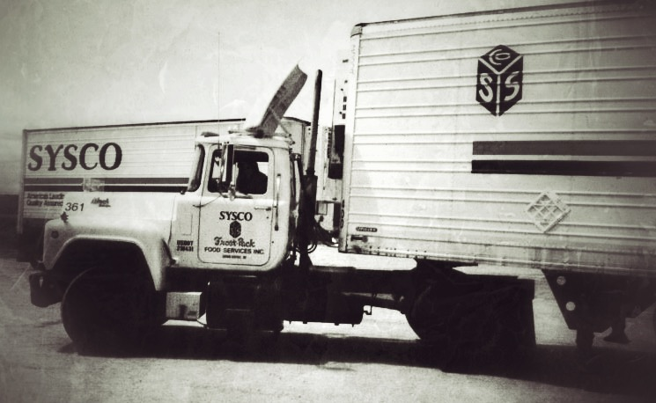
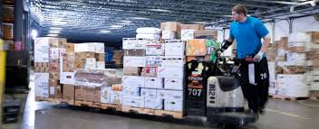
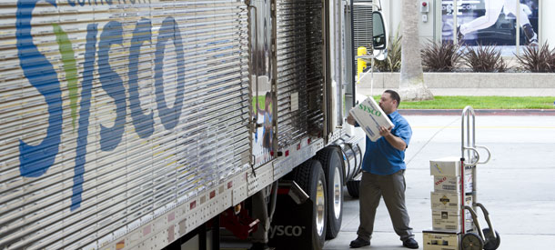
Sysco disrupted the industry and became massive

Slide 29
Time generates very powerful forces
1
The force of history and success (culture)
2
The force of massive size and scale
3
The force of an operations, day-to-day focus
4
The force of playing defense

Slide 30
“as a big company you CAN disrupt”
Is it disruption or destruction?
Some see it as destruction no matter what
Failures are good; or are they?
So what do you disrupt as a big company?
What you do and how you do it?
How you see yourself?

Slide 31
a big company starts with how it sees itself
Disrupt – or transform – the way Sysco sees itself
Transform from an order taker and distributor
To a solutions provider
Then to an information company
So how do you start?
Mani says to do something crazy

Slide 32
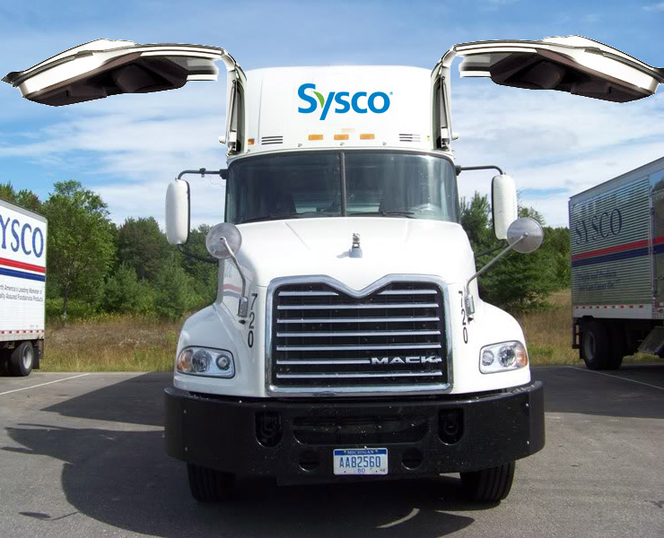
be crazy

Slide 33
you actually can’t be crazy
What you need seems so simple:
Visionary and vocal leadership
Evangelists who fight the fight every single day
Focus
None of that is very easy at all
No crazy because the core will isolate and eat you

Slide 34
Focus: incrementally disrupt how we see ourselves
Technology solutions & team…going beyond food and trucks
Millennials: see that our associates, customers, consumers are changing

Slide 35
disruption happens when we change our self view

Slide 36
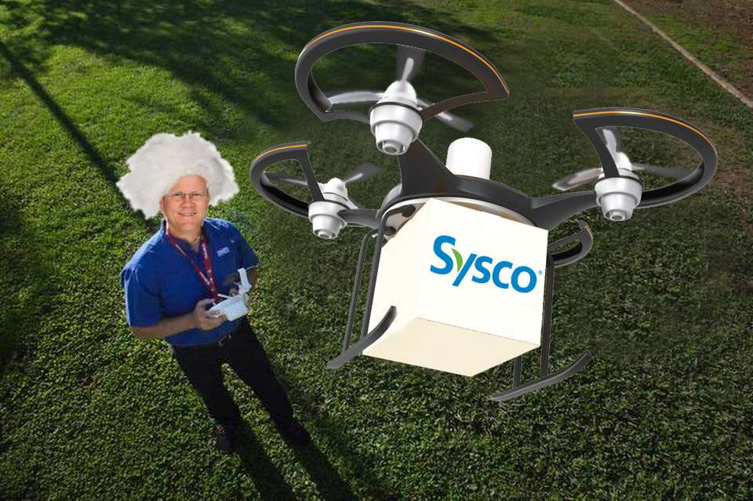
only then can we disrupt what we do & how we do it

