Slide 1

Branding in a Sea
of Digital Chaos
Poonam L
Digital & Brand Experience
Notes:
Why digitalize your brand?
What is a brand? A promise made as a result of an expectation
What is good branding?
Keeping that promise to start a relationship with consumers
Engaging with consumers regularly to grow the relation
Building on the promise to meet changing consumer expectations
You’re doing all this already... Then why digital?
Because the world as we knew it has changed….a new consumer has emerged

Slide 2
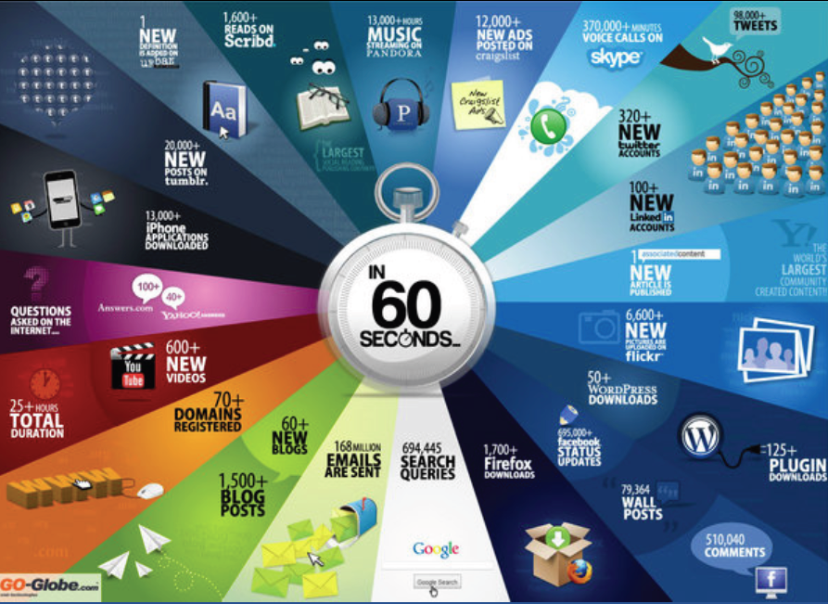
What happens every second on the Internet?
DATA EXPLOSION
Notes:
Add to it big data, omnichannel, crowd souricing, growth hacking …whoo

Slide 3

Whoa or WOW?

Slide 4



The NEW Consumer
Fast. Smart. And can’t be taken for a ride
Searching
for products or services anytime and from anywhere
Liking
products and brands that meet their promise
Sharing
their ‘likes’/dislikes about these brands on public forums
Make her your friend, your follower, your brand champion.

Slide 5
The Digital Market Today
Always On!!
The average adult spends one quarter of their time on
The Internet
90%
of data in the world today
2 years
Was created in the last
Nearly
1 in 3
Digital media minutes is spent on a mobile device
Prediction: 5 years from now, CMOs will spend more on IT than CIOs
Notes:
121 minutes daily on social, 25% don’t remember the last time they were away from their smart phone.

Slide 6

So what do big brands do
in the digital space?
LESS
They simply do

Slide 7
Doing LESS??
…what does it mean?
Listen
Listen to conversations happening online, relevant
to your product or service
Engage
Engage customers through regular feedback and interactions. Make them your friends.
Solve
Solve your customers’ problems, queries and
doubts, just as friends do.
Share
Share information and valuable content about your business with them.

Slide 8
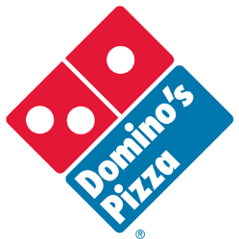

“LESS-ON” the Hard way..
Why LESS is MORE?
Video prank by employees and the power of internet
damages reputation of Domino’s in less than a day!
1 million
views
High search ranking
on Google
Wide-spread discussions on Twitter
In less
than a day
Saving $1,200 cost United Airlines
10,772,839 negative views on YouTube
2.5 million
views
12.5 million negative impressions
across digital media
Notes:
Don’t underestimate the internet, example 1
The video, filmed as a prank, showed an employee violating health-code standards while preparing the food in the Dominos kitchen.
And then they posted it online!
Dominos took two days to respond with a public apology on YouTube.
Don’t underestimate the internet, example 2
In 2008, United Airlines broke Canadian musician Dave Carroll’s guitar in transit
To top that, they behaved completely indifferent to his complaints
In protest, he wrote a song about the whole episode and posted it on YouTube
Till date the video has garnered more than 2.5 million views and
12.5 million negative impressions across digital media

Slide 9
POE to create your brand’s digital identity
PAID
OWNED
EARNED

Slide 10


Digital Tools
The Paid, Owned, Earned (POE) Ecosystem
PAID
OWNED
Print & TV
Corporate Website
For the general consumers
3rd party web banners
Portals & Microsites
For customers and prospects
Paid Search
Social Media pages
Media Deals
Mobile Website and Apps
EARNED
Likes & Shares
Creates the super consumer
Your Brand Champion
Tweets & Posts
Blogs & Conversations
Creates fans and followers
Comments & Ratings

Slide 11
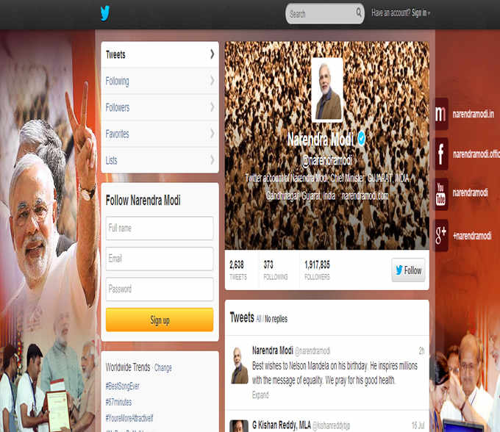
The PERFECT example of POE use

Slide 12
Creating a Customer
Experience
ACCESS
COLLABORATE
ENGAGE
CUSTOMIZE
CONNECT

Slide 13
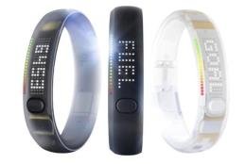
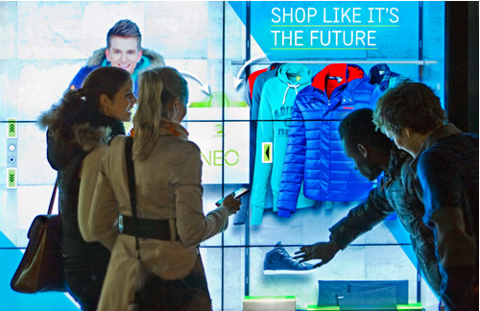
ACCESS
Be present where the consumer is.
Nike Fuelband: Embedding the Network
Always with the consumer, collecting real-time feedback on their performance and facilitating online sharing
Adidas NEO concept stores
Enabling window shopping consumers to literally shop from
a window using interactive mannequins and a cool, funky UI

Slide 14
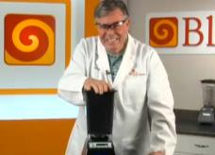
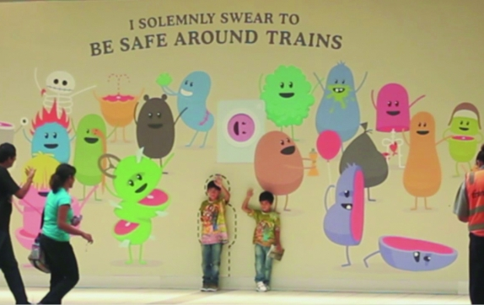
ENGAGE
Become a source of valued content.
Blendtec: ‘Will it blend?’ whacky video series
131
294 million
episodes
Views till date
Melbourne Metro’s morbid but meaningful
‘Dumb ways to die’ campaign
4.7 million
30 million
Views in
Views till date
72 hours
Notes:
The content must be original and related to your business – it need not necessarily be sensible…
BlendTec: Once a small manufacturer, currently active in 90+ countries, Blendtec is known to millions thanks to its crazy "Will It Blend?" videos – one of the most successful viral awareness campaigns
Melbourne Metro: A public service announcement campaign by Melbourne Metro to promote rail safety used used black comedy and featured “21 characters killing themselves in increasingly stupid ways" with the last 3 characters being killed by trains due to unsafe behavior

Slide 15


CONNECT
Be a part of your customers’ lives through conversations
March of Dimes Prematurity campaign
80 Ads
3,000
submitted
Votes cast
Winning ad was distributed on national TV.
McDonalds Canada’s ‘Our Food. Your Questions’ campaign
16,000
10,000
Questions asked
Answered
Some even through video ads!
Notes:
Let your customer realize that you are on their side
March of Dimes Prematurity campaign: Allowing people to make their own 60 second ad to raise awareness of premature births, and share stories through videos and blogs.
McDonalds Canada’s : This program invited any Canadian to ask any question whatsoever about McDonald’s food on a special website. To ask a question, you must connect with Twitter or Facebook, providing social visibility.

Slide 16
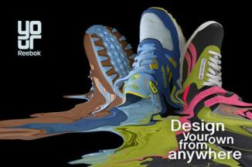
CUSTOMIZE
Adapt your offering to your customers’ needs
Reebok’s Freestyle Hi Shoe campaign
80,000
Users designed their own shoes
Followed up by the “Your Reebok” mobile app.
Notes:
Reebok: The campaign let consumers design their own shoe and, share it with friends and post it on their own pages.
Coca-Cola: show video, don’t talk about it

Slide 17
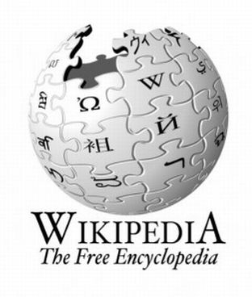
COLLABORATE
Involve your customer and co-create with them
An Encyclopedia for people by people
The world’s biggest free-content, collaborative online encyclopaedia
A wiki is a website that allows contributors to create and edit the wiki’s own pages using a simplified editor within the browser.`

Slide 18

Perfect Example of AECCC strategy

Slide 19
Going Digital is an
Organizational Move!
Product Development
Marketing
Online Presence
Feedback Loop
Early Warning
New Product Ideation
Demand Forecast
Lead Generation
Message Reach
Ratings & Reviews
Communities
Customer Stories
Sales
Customer Service
Communication
Leads
Collaboration
Thought Leadership
Blogs
Listening
Support Widgets
Outreach
Rich Media
Brand Reputation
Influence

Slide 20
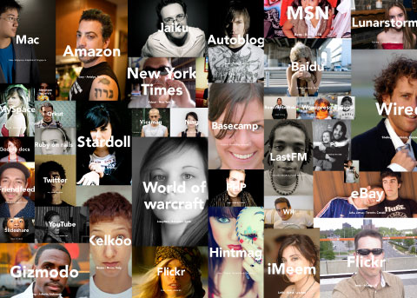
What is the world’s most powerful medium?
The Consumer

Slide 21

Do LESS..Get SMART!!
SMART Marketer MANTRA!
Listen
Specific
WOW!
Define objective and position
Measurable
Engage
Analyse
Achievable
Solve
Innovate
Reviewable
Customer Experience
Share
Test-learn, Test-learn, Test-learn
Time-bound
Always On
Create the ‘WORLD OF MOUTH’

Slide 22

The PERFECT example of LESS+SMART
Notes:
One company that got all of it right.

Slide 23
Thank You
Contact:
@PoonamL
Linkedin.com/PoonamL

