Slide 1

BRANDnew kNOT
Brand Summit May 2014 Sri Lanka
Notes:
I would like to title my talk to you Brandnew knoT… so on one hand is there anything new or not in brand building today… and also leave you to consider if we indeed need to build a brandnew KNOT with those we are here to serve…

Slide 2


SENSEassault
Notes:
Today we live in a world of SENSEassault …we are constantly being bombarded by everything we can sense.. Some of it is pleasant, some stark and not so pleasant… it is theses very senses that you are I today use to reach and thrill our consumers, those who buy and use our brands… and theses senses help us to day in and day out delight them and keep them with us…..

Slide 3
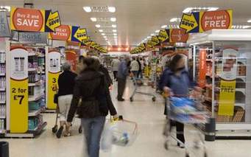
Marketer: role is constant
How can I influence BEST to CHANGE consumer behavior in favour of MY BRAND
Notes:
If a Marketer has one goal it is to reach the consumer.
It is to influence the shopper
It is to drive towards a behavior change
It is to ensure that the behavior change results in favour of your product brand or service.
So I’d like to put it to you that the role of a marketer has infact NOT changed….

Slide 4
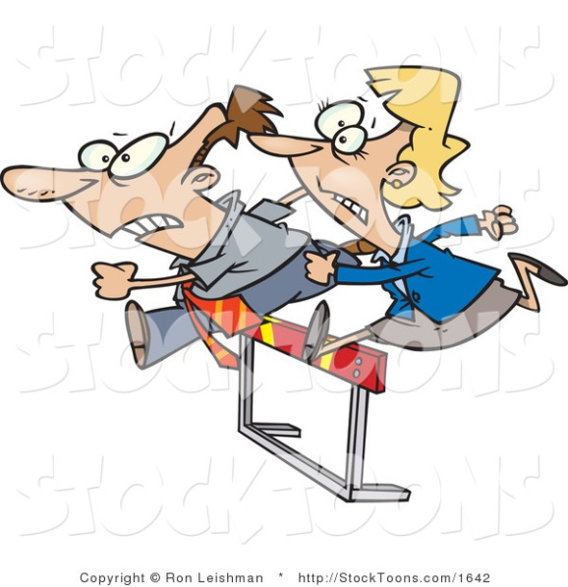





So what’s Changing.. What is New…..
Notes:
So what is changing … and what is new…..there are many local and global competitors that are competing with us in the market … they all want to WIN.. The race gets tougher, the ammunition sharper and harder…
The consumer has loads more in terms of choices… how DOES one choose??
Life is fast paced… many roles, efficiency, value, delivery MUST be spot on – no time or money for experimenting…
Social media is exploding, I know almost instantly where my friends shopw where they go, what they do… to belong I need to follow…. Be apart of it…WOM is so strong that it doesn’t really matter if I see the ad or not… not that I actually see the ad anyway…..
AND SO today lets try to answer 2 questions ….

Slide 5
r BRANDS .. still influential in decision making ?
r v BUILDING BRANDS that people LOVE 2 buy
Notes:
I want to leave before you two questions….

Slide 6


Do Consumers still BUY BRANDS
PRICE alone 16% to 7%
BRAND alone 43% to 59%
Millward Brown’s seventh annual BrandZ report based on trends in the past 10 years
Notes:
How many say YES…. Raise hands…
Milward brown survey in 2012/2013 gloablly showed that over a 10 year period purchase lead by price alone had diminished and purchases lead by brand consideration alone were increasing…. So some food for thought to those of us who think that simply by slashing prices we can win consumers over… yes maybe for awhile but what are you offering that they would remain with you… what is the value, what are you delivering… what do you stand for??
With less time to experiment with consumers can’t take chances will I experiment with a brand of sauce I have never used to marinade my chicken for tonight, I have 2 hours to do this–probably not - so brand is important
I invest more in the few relationships I have – so I want to give the best – I don’t compromise, so brand is important
My looks matter …I need to be well groomed big boss is in town – my shirt/my gel bad day to trial – so brand is important
Peter Walshe, Millward Brown’s global BrandZ director says that
Those businesses that can communicate they
are “meaningfully different” are the stars that stand out in the global brand rankings…

Slide 7










Top Global Brands 2013
Growth
Years in Existence
Notes:
Have a look at the top 10 global brands in 2013… Y axis is growth, X is the no of years they have been in existence and the bubble give the size of each brand…
The top 100 global brands shows the top brands getting younger, while businesses that have a purpose beyond
profit – and women on the board – are thriving !!!!
As brands strive to build stronger deeper bonds and relationships with consumers… increasingly it can be see that there brands are not just built on innovative product or service ideas but on ideals.
Some brands, like Google, IBM, have obvious life improving ideals. Google exists to immediately satisfy every curiosity, IBM exists to help build a smarter planet.
Every business and brand irrespective of the industry can become more purposeful.

Slide 8












100 plus not out …..
175 yrs
163 yrs
162 yrs
146 yrs
144 yrs
127 yrs
126 yrs
121 yrs
108 yrs
108 yrs
123 yrs
108 yrs
107 yrs
107 yrs
105 yrs
101 yrs
Notes:
Have a look at a few more brands that have stood the test of time…. They are still brands that you would aspire to buy/use be seen using and not only you but also the next generations … like our kids…

Slide 9
What Lessons Can we Learn
Change with modern times – must be relevant
Universal appeal – local roots
Brand promise – unchanging, uncompromising
Strong value proposition
New business YET not abandoning core
Brands with not only margins and bottom line at heart BUT a strong sense of Purpose
Notes:
Will have examples for each of these to bring alive

Slide 10

YES - Brands are Influential in Choices
Connected. Delighting. Satisfying. Rewarding. Enjoyment. Thrilling. Empathizing. Helping. Inspirational. Aspirational. Happiness. Fulfilling. Good Value. Successful. Inclusive.
Notes:
I think I will say a BIG YES… PROVIDED that … all of these adjectives are ones that your brand is able to deliver and fulfill in the consumers life… pretty tall order ha??
Yes … but we are like that right… we want everything. We want it all. From our spouses from our children from our homes from our teams from our workplace so why not from the brands we pay for and buy???

Slide 11

BRANDS .. r very much influential in decision making ?
r v BUILDING BRANDS that people LOVE 2 buy

Slide 12
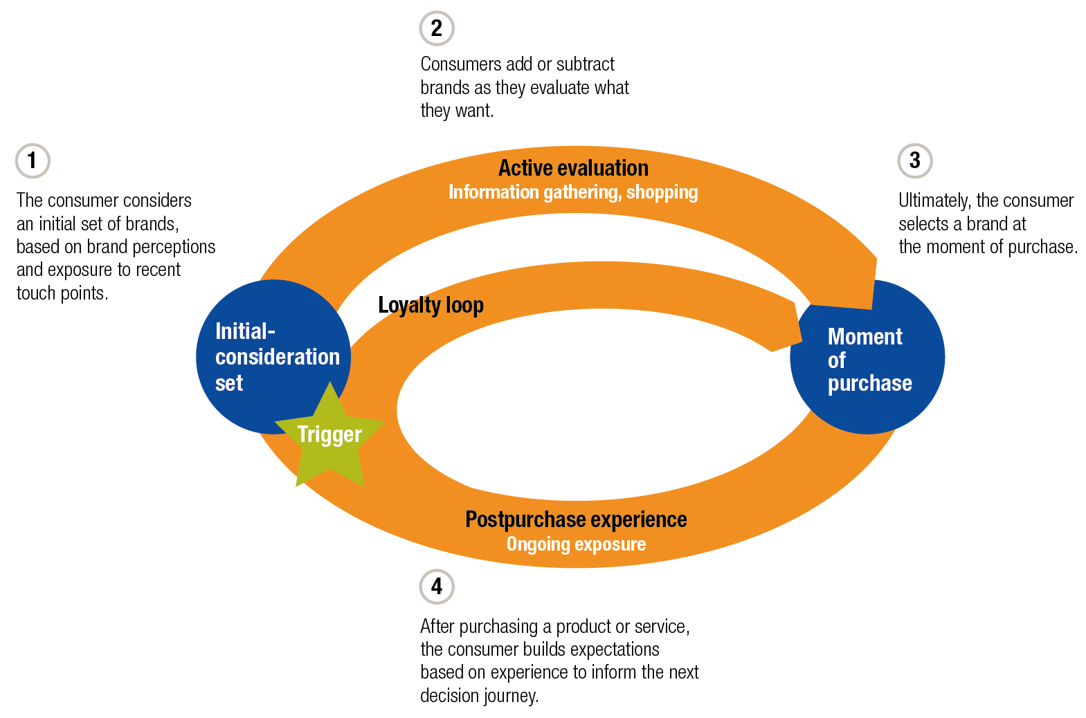
Cycle of Purchase…..
Notes:
In this cycle of influence purchase and experience I believe the 2nd and 4th and the most critical. Often we spend least of our time energy and money on ensuring we win at these moments in the purchase cycle.
In the past a robust media plan resulting in high TOM would be sufficient to ensure we remain TOM at the POP. Not anymore… this is the age of INFLUENCE
DOES frame work
D: Digital from websites to being top on search to being linked on sites…
O: Opinion formers – experts/bloggers/ambassodors
E: Endorsers … how can we make our loyal base our endorsers/ambassodors
S: Power of Social to spread positive experiences and of course watch for the negatives and manage it quickly

Slide 13
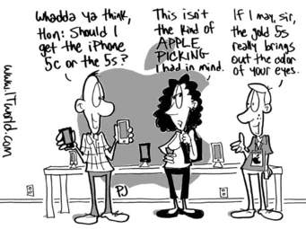
Age of INFLUENCE

Slide 14
Age of INFLUENCE
This is a once in a life decision… so don’t regret it for the rest of your life ok ….
Is this really good….
Parts are a real problem
My BIL had a really lousy experience not once but twice….
Check the small print in the brochure
Thathi.. I want
Machang this is a real beauty… I never believed but now that I bought it…
See for your self… check it out
Notes:
Lets say you were considering buying a car… maybe you have a few brands in your TOM… Honda, you are a Honda person and so necessarily you would want to consider a Honda. Toyota, you’ve heard about good after sales, and Lancer, nice interiors…
So now you can’t buy 3… and so begins your “fact finding journey”…
Now in the past… your mind would filter out two of the three based on what you see/are told etc and you end up buying the one that passes the last filer.
Not anymore …
In your search….
You could stumble on a dark horse so to speak that you’ve never considered
Good reviews
Your brother in law’s friend in so happy with his purchase
You met a guy who works at the garage…
and suddenly TOM of the earlier 3 pale into insignificance …. Another brand has now taken the place …
Or else
You could meet someone who’s had many lousy experices of the 3 you are considering ….
Suddenly you drop one…like a hot potatoe…..
But the BM on the brand is happy he is getting a good media plan.. good visibility good placement

Slide 15
Cycle of Purchase…..
D
O
E
S
Notes:
In this cycle of influence purchase and experience I believe the 2nd and 4th and the most critical. Often we spend least of our time energy and money on ensuring we win at these moments in the purchase cycle.
In the past a robust media plan resulting in high TOM would be sufficient to ensure we remain TOM at the POP. Not anymore… this is the age of INFLUENCE
DOES frame work
D: Digital from websites to being top on search to being linked on sites…
O: Opinion formers – experts/bloggers/ambassodors
E: Endorsers … how can we make our loyal base our endorsers/ambassodors
S: Power of Social to spread positive experiences and of course watch for the negatives and manage it quickly

Slide 16
5 Principles : To Win Amidst the Clutter
Unlock the Magic to Surprise and Delight in life
Facilitate Experience to Realize the unmet needs
Create Connections to Build bonds that add to life
Nurture Trust to Strengthen relationship
Build Love to add Colour & Purpose to life

Slide 17
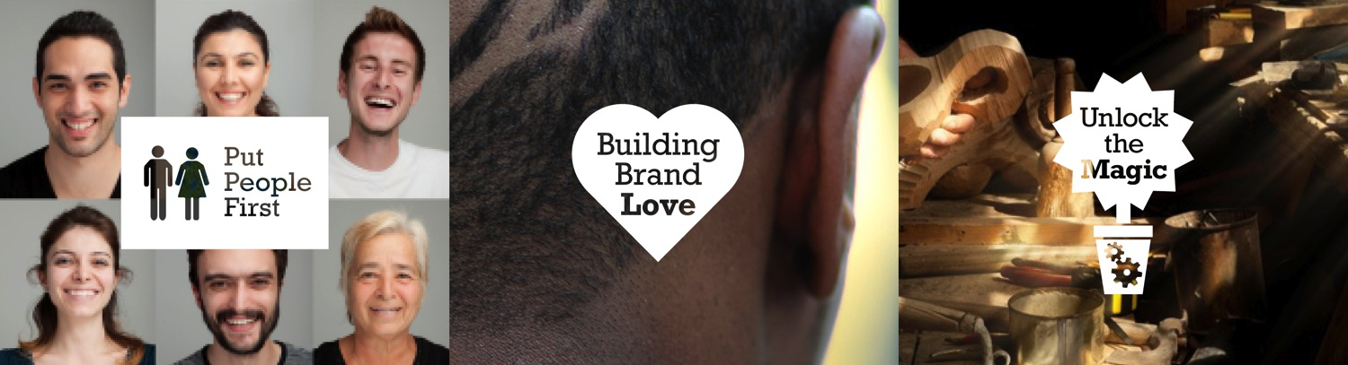
brandNEW KNOT

Slide 18
Implications for Marketers today
Anticipate and influence “Influencers”
Be where your TG is – literally and choice of “channels”
Balance between brand sales TO and brand relationship building
Profit vs Equity Building
Deliver the Promise … no shortcuts/no compromises
Does your brand have a Purpose in Life

Slide 19
Astra Inspire AV

Slide 20
Astra Case in a nutshell
Unlock the Magic
  Happiness of a finished tiffin box, Sensory impact of taste, aroma vs current behavior
Facilitate Experience
  Events, Eateries,
Create Connections
  With mothers via youtube/FB, with kids in school vans, Nutritionists
Nurture Trust
  KOF endorsement, PR, P&S
Build Love
  Nutrition and Growth of Kids, Nutrition pilot in rural school

Slide 21
“To do a common thing uncommonly well brings Success”
Henry John Heinz

