Slide 1


Slide 2
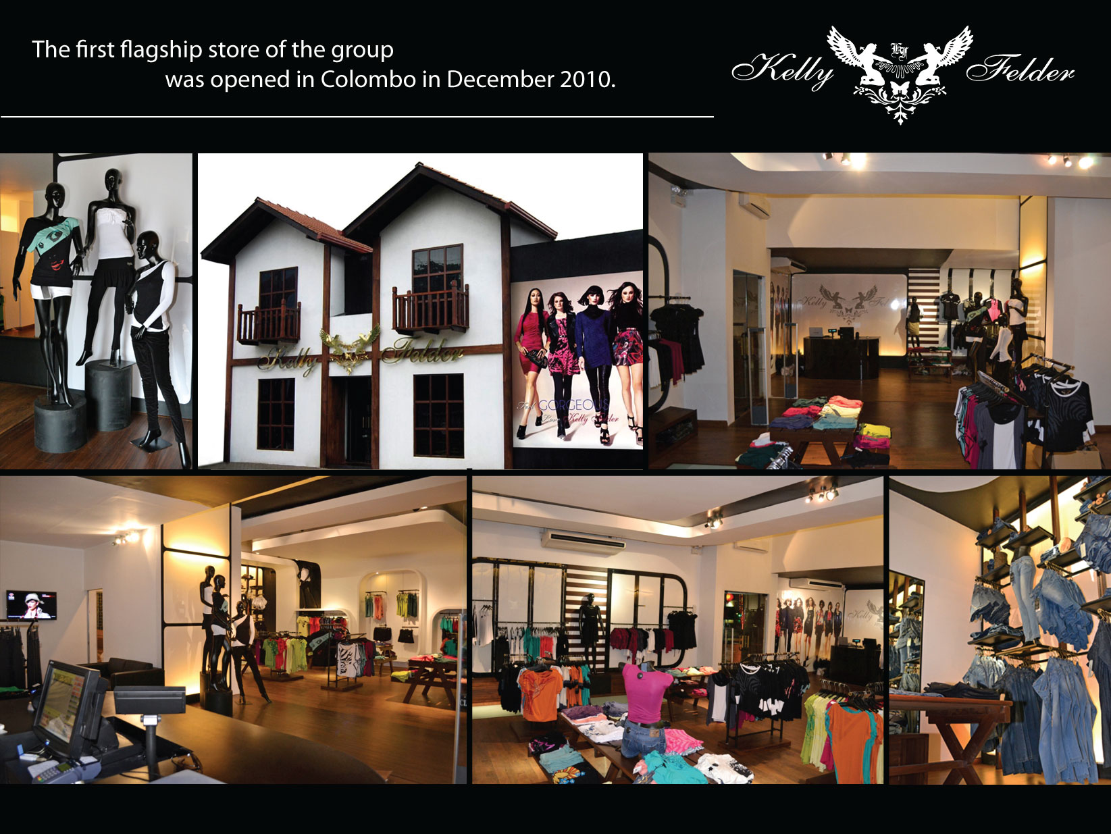
Notes:
gfhh

Slide 3
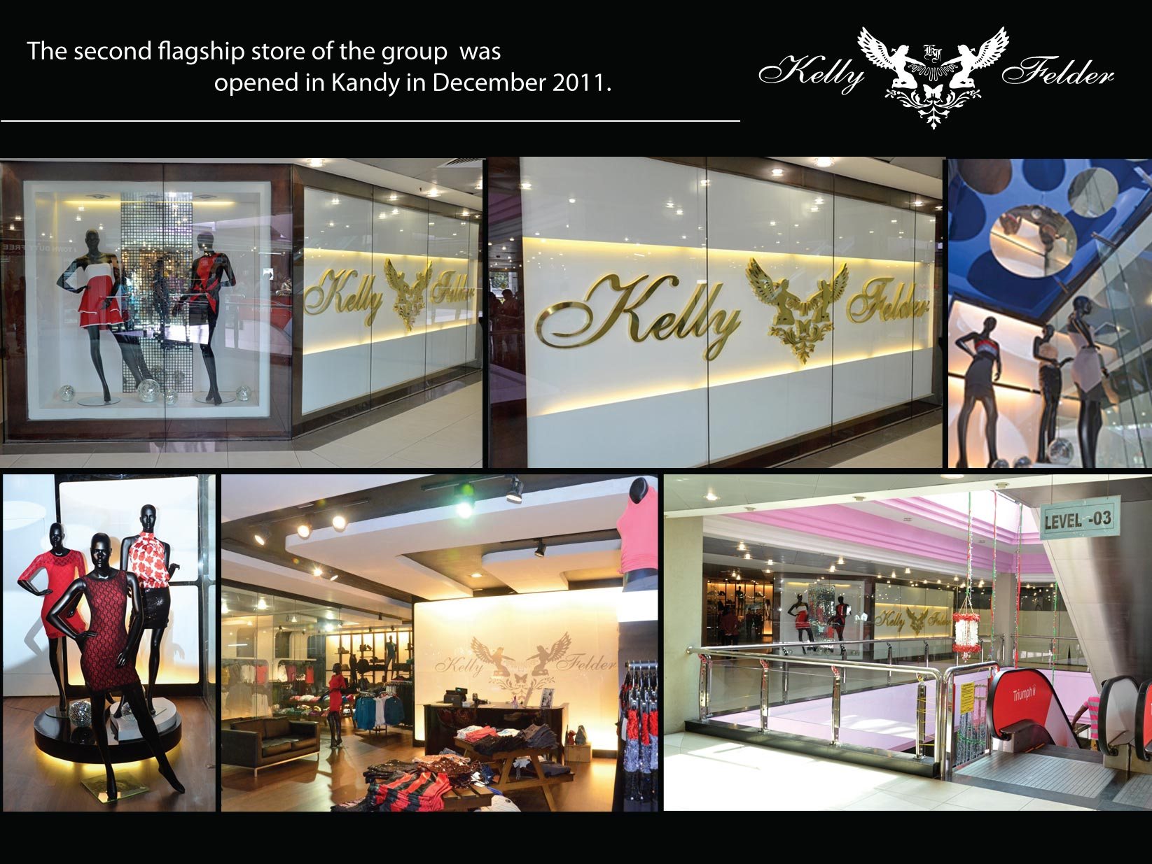
Notes:
gfhh

Slide 4
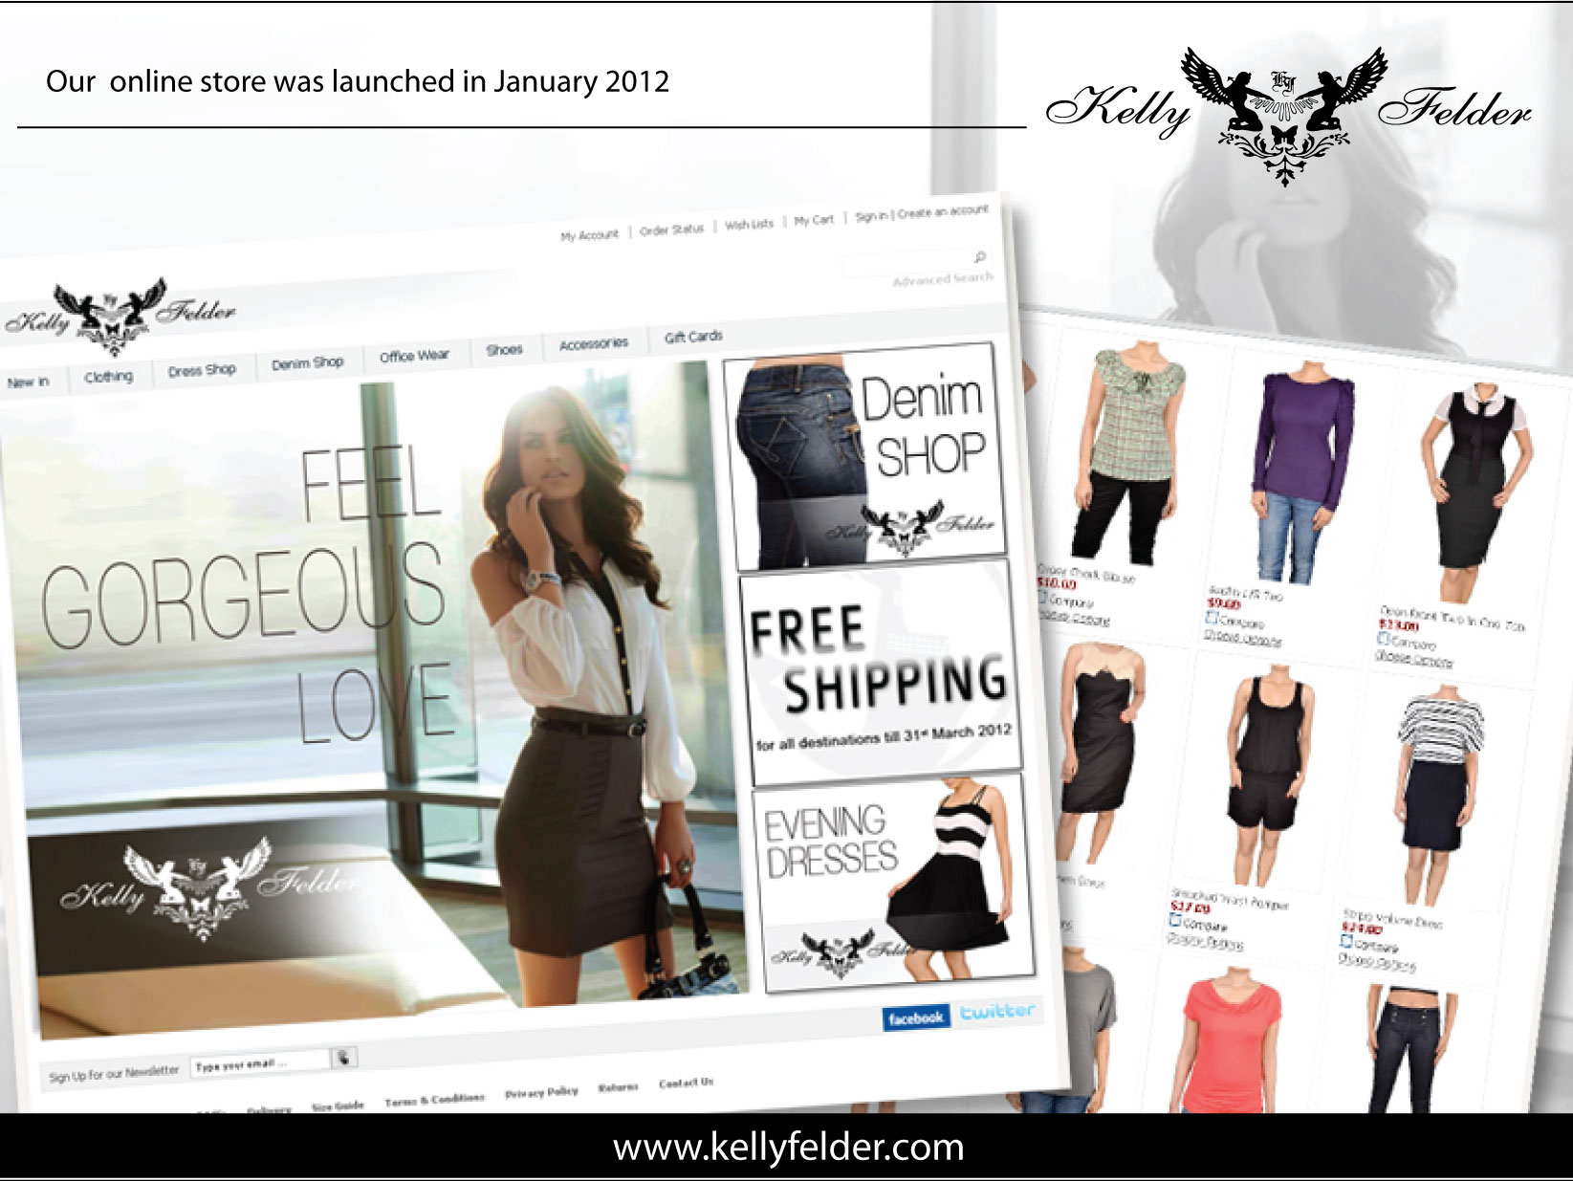
Notes:
gfhh

Slide 5
Introduction - Kelly Felder
Our mission is to develop the brand as an international chain of stores.
We are in the process of registering the brand in US and position as a US based Sri Lankan brand.
We have two stores in Sri Lanka and an online store kellyfelder.com to serve the international customers.

Slide 6
How We Used Digital Medium to Create Engaging Communication
Understanding the customer
Selecting the Medium
Audience Growth
Engagement
Advocacy
Influence

Slide 7

Understanding The Customer
Millennialist are totally a digital generation.
Client is in the center of our business
How to get them engaged & create value.
Understanding emotional and rational decision making process.
How evolving youth culture influence the choice, and how well we can fit in to the youth eco system.
Kelly Felder has been very successful in identifying the space and knowing the dynamics of the environment.

Slide 8



Selecting the Medium
Best ROI
Measuring the effectiveness
Obvious choice and we decided to engage through social media
Knowing the analytics and know when to share the best content.
We had to know "WHY" – we know why we use social media and the expected end result
Meeting the customer requests real time

Slide 9
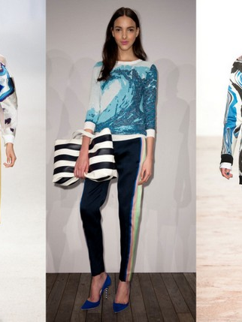
Audience Growth
Real & authentic
Personal contact
Innovation
FB as the main platform
Appealing content
160000 fan base with up to 10000 weekly engagement and 600000 weekly reach

Slide 10
Engagement
Live engagement with the community
Faster response.
Monitoring customer engagement using various tools and services available out there
“Buzz Monitoring”
Ever changing rules of customer engagement.

Slide 11
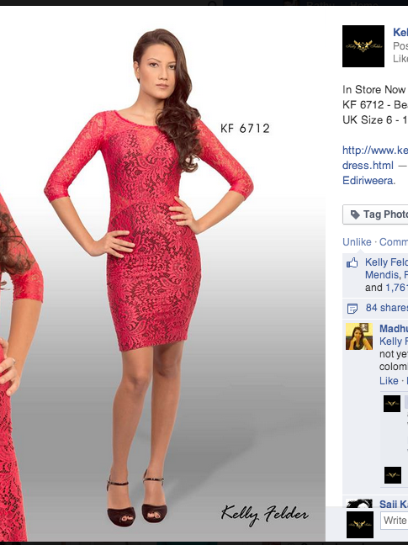
Advocacy
Influencers vs brand advocates
Highly satisfied customers
They recommend others
They help others to choose our brand
Brand loyalty
Facebook is a conversation, not a monologue

Slide 12
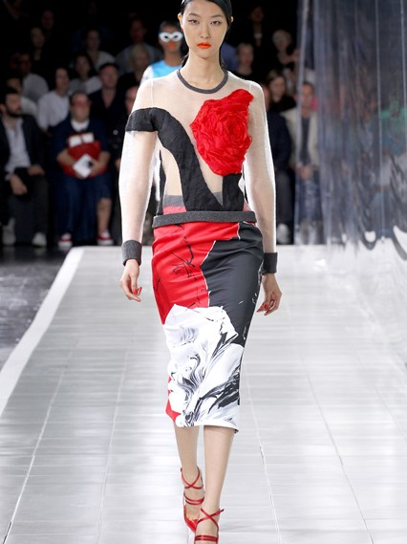
Influence
Influencing consumer behaviour
Digital medium has influenced the customer choice.
Social media insights have helped us with our designs, new products, seasons and content.
An ever evolving strategy on how we influence

Slide 13
The Future
We are yet to utilise all resources available in social media
Our audience is young, vibrant, tech savvy, ambitious, unique, confident and growing.
Youngsters are embracing technology and social media is becoming more valid
Smart phones, wearables and connected devices are on the rise
Social media is not a fad but here to stay
Whether to embrace is not a choice but mandatory
Customer engagement would be the key to success
Customers will drive the success of the brand
We just need to know how to and when to engage

