Slide 1
Towards a Culture of Innovation
Sanjiva Weerawarana, Ph.D.
Founder, Chairman & CEO
LBR LBO Summit on Enterprise 2.0 “Building Future Ready Enterprises” – October 4, 2013

Slide 2
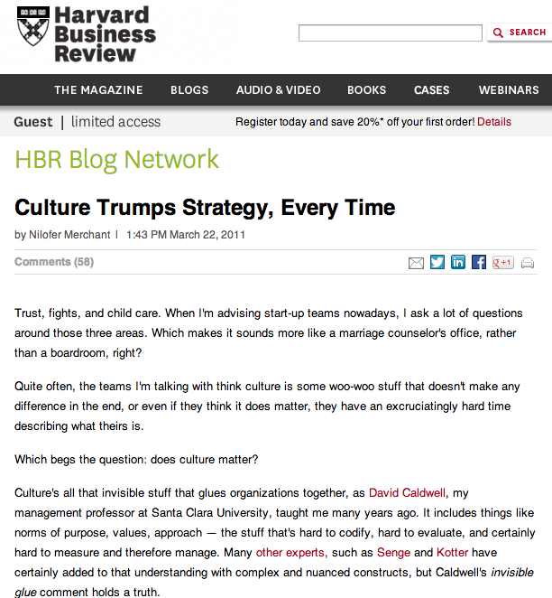
What is “culture”?
Culture is a formula for on-going, dynamic, iterative, constructive improvement

Slide 3
Culture facilitates innovation
Passion
No broken windows
Question everything
Commitment
Ask for forgiveness, not permission
Be human
Meritocracy
Clean up after yourself
Results, not process
Honesty
Context, not rules
Iterate everything
No jerks
No hierarchy
No 9-to-5
No sir/madam
Failure is normal
No politics
Integrity
No sacred cows

Slide 4
Culture is all about people
Committed to winning
Work hard
Dedicated
Passionate
Work-life balance
Self-motivated
Committed to excellence
Play hard
Confident
Everyday learning
Empowered
Personal vision
Personal brand

Slide 5

Culture is not a constant
fight for the culture the way it should be…not the way it was or the way its becoming.
Chamath Palihapitiya
VP of Platform at Facebook as he was leaving Facebook
http://techcrunch.com/2011/06/03/facebook-vp-chamath-venture-socialcapital/

Slide 6
Youth and culture
The older I get, the narrower my views become
I’ve seen too much and know “that won’t work”
Managers don’t always know better!
Learn to manage your manager
Take a risk
And accept failure

Slide 7
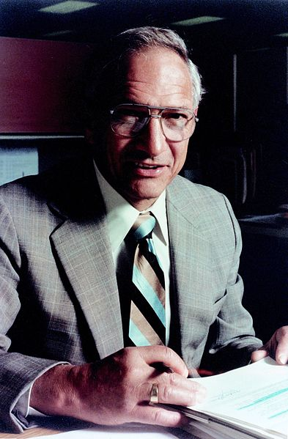
Don’t be encumbered by past history.
Go off and do something wonderful.
Robert Noyce
co-founder of Fairchild Semiconductor
and Intel Corporation

Slide 8
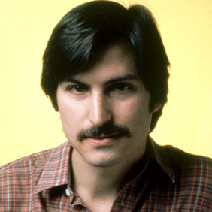

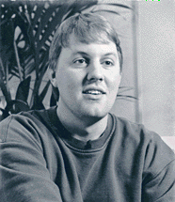
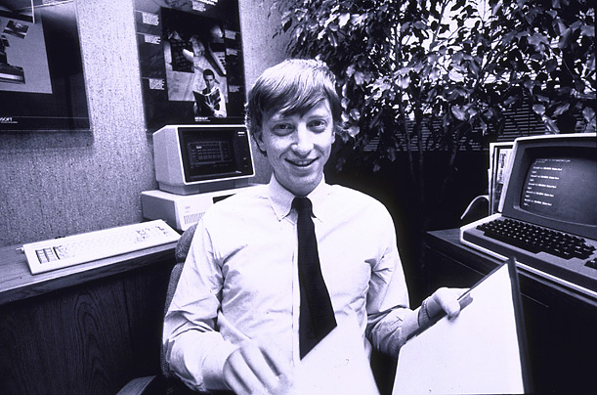
Some young people who changed the world

Slide 9
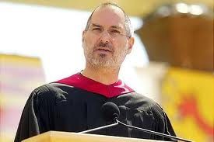
No roadmap for innovation!
You can't connect the dots looking forward you can only connect them looking backwards. So you have to trust that the dots will somehow connect in your future. You have to trust in something: your gut, destiny, life, karma, whatever. Because believing that the dots will connect down the road will give you the confidence to follow your heart, even when it leads you off the well worn path.

Slide 10
Summary
Innovation and culture go hand in hand
Culture fuels innovation
Culture is not a constant
Fight for the future, not the past
Innovation is not just about products and services
About how you do everything
Never settle .. Its never good enough
Or someone else will do it better than you

Slide 11

The Journey is the reward.
Steve Jobs
Co-Founder, Chairman & CEO
Apple

